Slide 1
Professional Learning
One-on-One and
Small Group Instruction
www.osyconsortium.org

Slide 2
Acknowledgements
Professional Development Group and Contributors:
Lysandra Alexander (PA), Susanna Bartee (KS), Odilia Coffta (NY), Joan Geraci (NJ), Tracie Kalic (KS), Sabrina Pineda (GA), Kiowa Rogers (NE)
Professional Development Reviewers and Technical Support Team members and the State Steering Support Team
www.osyconsortium.org

Slide 3
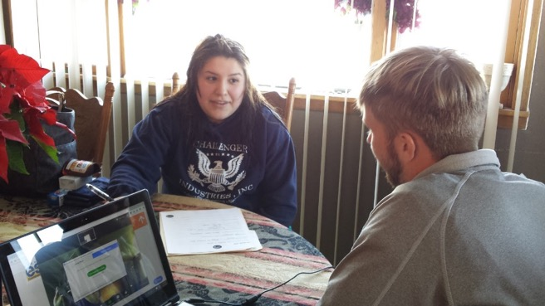
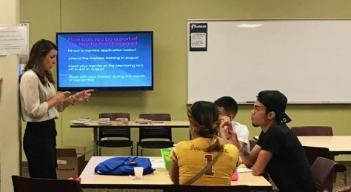
Statement of Purpose
This module will instruct you on teaching strategies to use with your OSY in one-to-one or small group settings.
www.osyconsortium.org

Slide 4
Tips & Techniques
Relax and be yourself
Establish rapport
Respect your students
Maintain confidentiality
Be sensitive to individual needs
Be informative without being intimidating
Be positive – praise students’ efforts and successes
Encourage independent learning (teach them to fish)
Be patient
Use effective questioning (ask rather than give answers)
Be flexible
Focus on “learning how to learn”
Be a good listener
www.osyconsortium.org

Slide 5
Before the Lesson: Elements to Consider
The student’s level of readiness— How prepared are they to learn specific
information or skills? An informal assessment should be conducted to make this determination.
Interest – What appeals to the student’s interests?
If they are interested in what they are being taught they will be more motivated to learn.
Determine what they like, their hobbies, which sports, places, or food they enjoy.
Learning Profile – How the student approaches learning and learns best:
visual, auditory, kinesthetic, multi-modality
www.osyconsortium.org

Slide 6
Before the Lesson: Questions to Consider
What does my student or group already know?
What does my student or group need to know?
What does my student or group hope to learn?
How can I best meet the needs of my student or group without giving the answer?
How can I conduct myself so I make the learning experience a positive one?
www.osyconsortium.org

Slide 7
Comparing Instructional Settings
One-on-One
Small Group
Time allows the individual student to ask specific questions
Student is instructed and lessons paced at his/her level
Goals are established to meet the individual student’s needs
Allows for individual perspectives and approaches
Students may interact more with each other, less with instructor
Multiple abilities and backgrounds require adjusted pacing
Goals are designed for the general needs of the group
Allows for multiple perspectives and approaches
www.osyconsortium.org

Slide 8
Tips for One-on-One Instruction
Keep your lesson real and relatable.
Help students apply learning to their daily life.
Make sure to vary your approach to keep it
fresh.
Utilize humor.
Tailor lessons to student’s interests or needs.
Foster independent learning.
Pause frequently and wait for student to
respond to questions.
www.osyconsortium.org

Slide 9
Tips for One-on-One Instruction cont…
Encourage creativity.
Assess through games.
Seek feedback (ask the student
whether he or she is finding the lessons
valuable and how to improve).
Cater the lesson to the student’s learning style.
www.osyconsortium.org

Slide 10
Considerations for One-on-One Instruction cont…
An advantage of working one-on-one is the ability to differentiate or personalize the lesson:
Consider the background and life experiences of the OSY.
Each OSY brings unique strengths.
Each OSY also has different educational needs / learning styles.
The same lesson may need to be presented in different ways to meet the individual needs of each OSY.
Technology can be an effective tool for extending learning but prioritize the teacher-student interaction whenever possible.
www.osyconsortium.org

Slide 11
Considerations for One-on-One Instruction cont…
Creating an effective learning environment is key when working one-on-one with OSY:
Consider safety.
Ensure that instructor / student interactions are consistently professional.
Focus on education rather than social conversations.
Be aware that there may be distractions even when working one-on-one.
www.osyconsortium.org

Slide 12
Tips for Small Group Instruction
Make sure everyone in the group gets a chance to participate:
Use a circular seating arrangement.
Provide opportunities for quiet/shy students to speak.
Ensure that every student can see the instructor and materials.
Be aware of students’ abilities and adjust lesson as needed.
www.osyconsortium.org

Slide 13
Tips for Small Group Instruction
Pair students with strong skills with students whose skills are developing.
Have students explain answers, concepts, and definitions to each other.
Summarize everyone’s contribution.
www.osyconsortium.org

Slide 14
Considerations for Small Group Instruction
There are many advantages to working in small groups:
Students can learn from one another.
Instructors can prepare materials to accommodate different ability levels.
Technology can be utilized to differentiate within a small group setting:
If a student already understands the concept you are presenting, technology can be a tool to challenge the student in another area.
If a student is struggling, technology can be a tool to reinforce the skill the other students have already mastered.
Within the same lesson, one or more student can utilize.
www.osyconsortium.org

Slide 15
After Instruction: Questions to Ask Yourself
Did I build on what my student or group already knew?
Did I address what my student or group needed to know?
Did I meet my student or group’s learning objectives?
Did I support the needs of my student or group without giving the answers?
Did I make the learning experience a positive one?
www.osyconsortium.org

Slide 16
After Instruction: Questions to Ask Yourself
How did student(s) feel about the learning session?
How did student(s) respond to the topic of the lesson?
How do I need to modify my lesson next time?
What instructional materials could I bring next time?
www.osyconsortium.org

