Slide 1
Hook, Line & Sinker:
How to Reach Out of School Youth through Trust and Persistence
Cori Canty, Tomas Mejia, Brenda Meyer
Colorado Department of Education, Office of Migrant Education
March 23, 2015

Slide 2
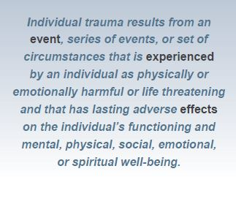
What is Trauma?
SAMHSA’s Concept of Trauma - The Three “E’s” of Trauma:
Event(s)
Experience of Event(s)
Effect
Event
Effect
Experience of Event

Slide 3
What is Complex Trauma?
The pervasive impact, including developmental consequences, of exposure to multiple or prolonged traumatic events.
Complex trauma typically involves exposure to sequential or simultaneous occurrences of maltreatment
Exposure to these initial traumatic experiences sets off a chain of events leading to subsequent or repeated trauma exposure in adolescence and adulthood”.
Trauma
Emotional Dysregulation
Loss of Safety
Inability to read danger
Notes:
National Child Traumatic Stress Network (NCTSN)

Slide 4
The ACE Study
Adverse Childhood Experiences (ACE)
  Abuse (emotional, physical, sexual)
  Neglect (emotional, physical)
  Household Dysfunction (mother treated violently, mental illness, substance abuse, parental separation or divorce, household member imprisoned)
CDC and Kaiser Permanente (San Diego): 17,000 participants

Slide 5




The ACE Study: Major Findings
Almost 2/3 reported at least one ACE
  More than 1 out of 5 reported three or more ACE
0
0
1
5
4
1
3

Slide 6

What is Secondary Trauma?
Compassion fatigue and secondary trauma refer to
  Physical changes and symptoms
  Psychological changes and symptoms
  Cognitive changes and symptoms
    that workers may encounter when they work with clients who have histories of trauma.
Vicarious trauma refers to specific cognitive changes, such as in worldview and sense of self.

Slide 7

What is Secondary Trauma?
“secondary trauma” = stress reactions and symptoms resulting from exposure to another individual’s traumatic experiences, rather than from exposure directly to a traumatic event.
Secondary trauma can occur among behavioral health service providers across all behavioral health settings and among all professionals who provide services to those who have experienced trauma (e.g., healthcare providers, peer counselors, first responders, clergy, intake workers).

Slide 8
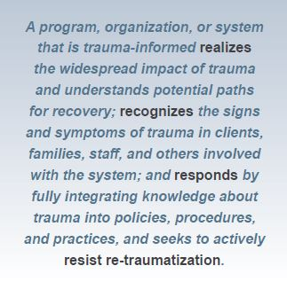
What do we do about it?
Trauma-Informed Approach
SAMHSA’s The Four “R’s”: Key Assumptions for a Trauma-Informed Approach

Slide 9
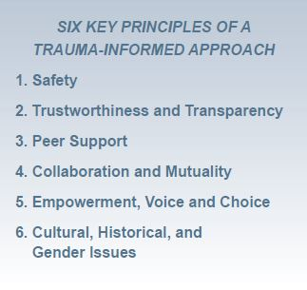
What do we do about it?
Trauma-Informed Approach
SAMHSA’s Six Key Principles of a Trauma-Informed Approach

Slide 10
Don’t Call Them Dropouts:
Five Conclusions
Students who leave school before graduating are stronger than popular opinion and current research literature describe. These strengths could, with the right supports, allow them to stay in school; and these abilities do, ultimately, help many to re-engage.
Students who leave school before graduating are often struggling with overwhelming life circumstances that push school attendance far down their priority lists.
Young people who leave high school need fewer easy exits from the classroom and more easy on-ramps back into education.
Young people who leave high school emphasize how much peers, parents, and other adults matter.
Everyone in a young person’s life and community can do something to help.

Slide 11


Don’t Call Them Dropouts:
Five Recommendations
Listen.
Surround the highest-need young people with extra supports.
Create a cadre of community navigators to help students stay in school.
Follow the evidence.
Place young people in central roles in designing and implementing solutions that will work for their peers.

Slide 12
Case Study: Reframing
Alex gets caught with drugs.
“Growing up my mom had three kids, single mom, and she also took care of her brother who was mentally disabled. And uh, we were poor, grew up poor and we lived [in a little town] surrounded by methamphetamine and biker gangs. It’s not the most kid-friendly place in the world to grow up … When I was eleven my mom came home and told us she had cancer and that was … a scary thing because I knew what cancer was, but I didn’t really know what it meant. Over the next couple years of my mom going through chemotherapy treatment and radiation over and over again, um she eventually went into remission at one point, which was good. That was my seventh grade year, I think … when she went into her first remission. But, she had lost her job going through chemotherapy treatment. She couldn’t work and go through that kind of treatment. We didn’t really have any other support. My grandfather had died when I was in sixth grade. He was kinda like my father figure up until that point. We were kinda on our own. We were broke… We didn’t have money, we couldn’t feed ourselves. I had two sisters and my uncle. I found out in [town] with a bunch of little rich white kids that cocaine is a very, very, very valuable resource to have, that and marijuana. And so, I started selling drugs really young.” — Alex

Slide 13
Case Study: Reframing
Rudy gets caught stealing things.
“When I seen him in the casket it hurt me. It really hurt me. I changed. Mind state when from If ‘I got it, you got it’ to ‘If you got it, I’mma get it.’ Whatever you got I want it and I ain’t asking for it. I’m gonna take it.” — Rudy

Slide 14

Strategies to Build Trust & Rapport
First….

Slide 15


Understanding your own trauma
Know your own triggers
  Personal trauma or secondary trauma experiences
Know who to and how to refer
  Who else can help you support the youth?

Slide 16
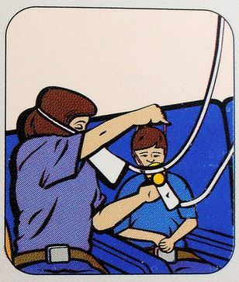
Then…

Slide 17
Building Trust & Rapport with Youth:
Interview Strategies
Characteristics of Successful Conversations
  * Low risk, with gradual increases * Reciprocal sharing
What do you love to eat?
What is your favorite holiday?
What word or words best describe you?
What is something that you wish your friends or family better understood about you?
Notes:
Give examples of low risk & high risk questions
When the youth shares, you could share your own story to model & encourage trust/opening up

Slide 18
Interview Strategies
Initial interview
  Use the Interview handout
  Practice with a partner
  4-5 minutes
  How many questions did you discuss?
  What stopped you from getting all the way through the questions?
Notes:
Pass out the interview questions packet
Allow pairs 5 minutes (?) to interview
Debrief – ask for sharing from group

Slide 19
Interview Strategies
Dreams and goals
  Example
    If I had time and resources to achieve my dreams, what would they be?
    What is a dream I have about work?
    What is a dream I have about education?
    What would I do if I knew I could not fail?
    What resources are already available to me?
    What obstacles get in my way?
    How can I overcome these obstacles?
    What can I do in the next three days to be closer to a goal?
    How can I plan for short and long term goals
      short (1 week to 4 weeks) Example: MP3 Player to learn English
      long (longer than 1 month) Example: Take an ESL Class
  Sharing from other states
Notes:
Getting youth to dream & how to focus them to turn the dream into a goal

Slide 20



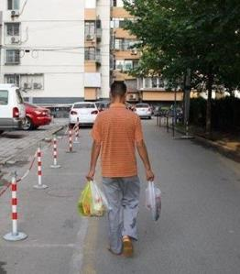

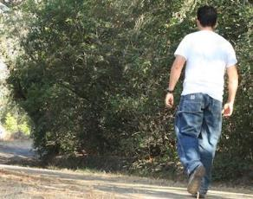
How many do you get?

Slide 21

Persistence: Celebrate Small Wins
What is considered a win?
How will you announce it?
How will you celebrate it?
Notes:
Baby steps: celebrating small wins

Slide 22

Persistence: Self-Awareness
Self-awareness:
  Frustration?
  Discouragement?
  Apathy?
Rejuvenate:
  Brainstorm
  Action Plan
Notes:
Self-awareness: signs of frustration & how to rejuvenate (brainstorm & start action plan)

Slide 23





Thank You

Slide 24
Trust & Rapport Strategies
Conversation/Interview Ideas
Persistence Ideas
Other strategies?
  Examples
  Sharing from other states

Slide 25
Review & Reflection
What will you take back to colleagues?
What do you need more information/resources about?

Slide 26
Resources
http://www.acestudy.org/home
http://www.cdc.gov/violenceprevention/acestudy/
http://m.theatlantic.com/education/archive/2014/12/how-teachers-help-kids-heal/383325/#disqus_thread
http://massadvocates.org/tlpi/
http://traumasensitiveschools.org/
http://store.samhsa.gov/product/SMA14-4884?WT.mc_id=EB_20141008_SMA14-4884
http://store.samhsa.gov/product/TIP-57-Trauma-Informed-Care-in-Behavioral-Health-Services/SMA14-4816
http://www.nctsn.org/trauma-types/complex-trauma/resources

