Slide 1
iSOSY SST Meeting
Welcome and Introductions
Doug Boline, State MEP Director
Kansas, Lead State
www.osymigrant.org

Slide 2
iSOSY SST Meeting
Agenda
Welcome and Introductions
Website Analytics
Work Group Reports
Entrepreneurial Course
Professional Learning Circles
Annual Performance Report Data
Discussion of New CIG Activities
OSHA Course and Future Course Options
Dissemination Plans and Trainings
Pre-HSE Course Pilot
Future Meeting Dates
www.osymigrant.org

Slide 3
iSOSY SST Meeting
Meeting Materials:
https://drive.google.com/drive/folders/1YanqUnvbhA6AWTbgqSIa1ZDl5C9yXNTU?usp=share_link
www.osymigrant.org

Slide 4
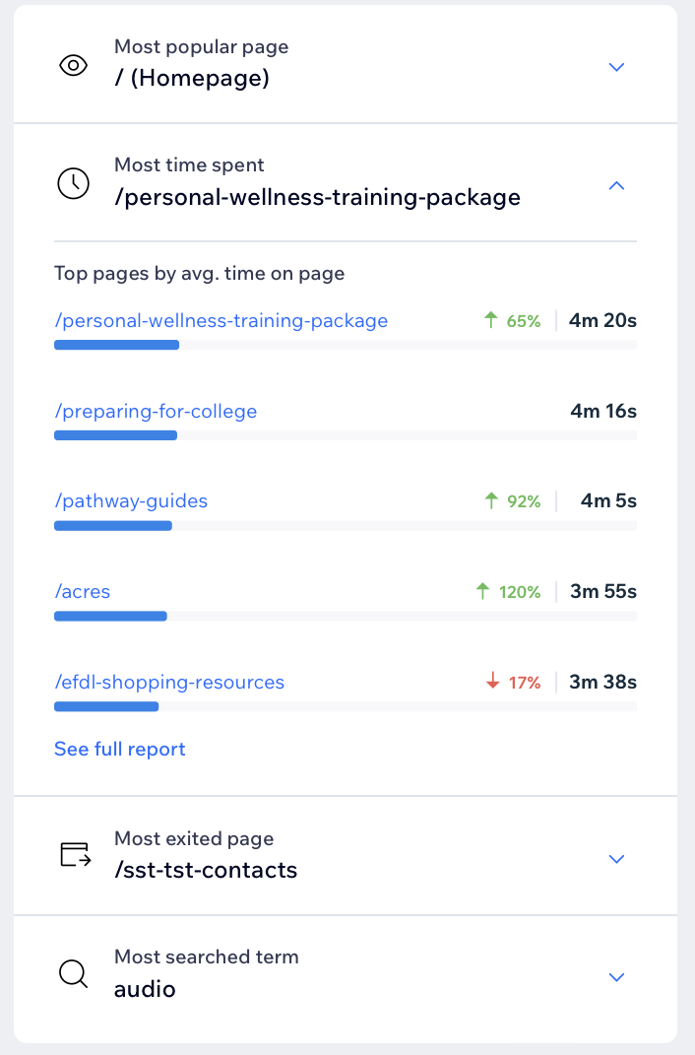
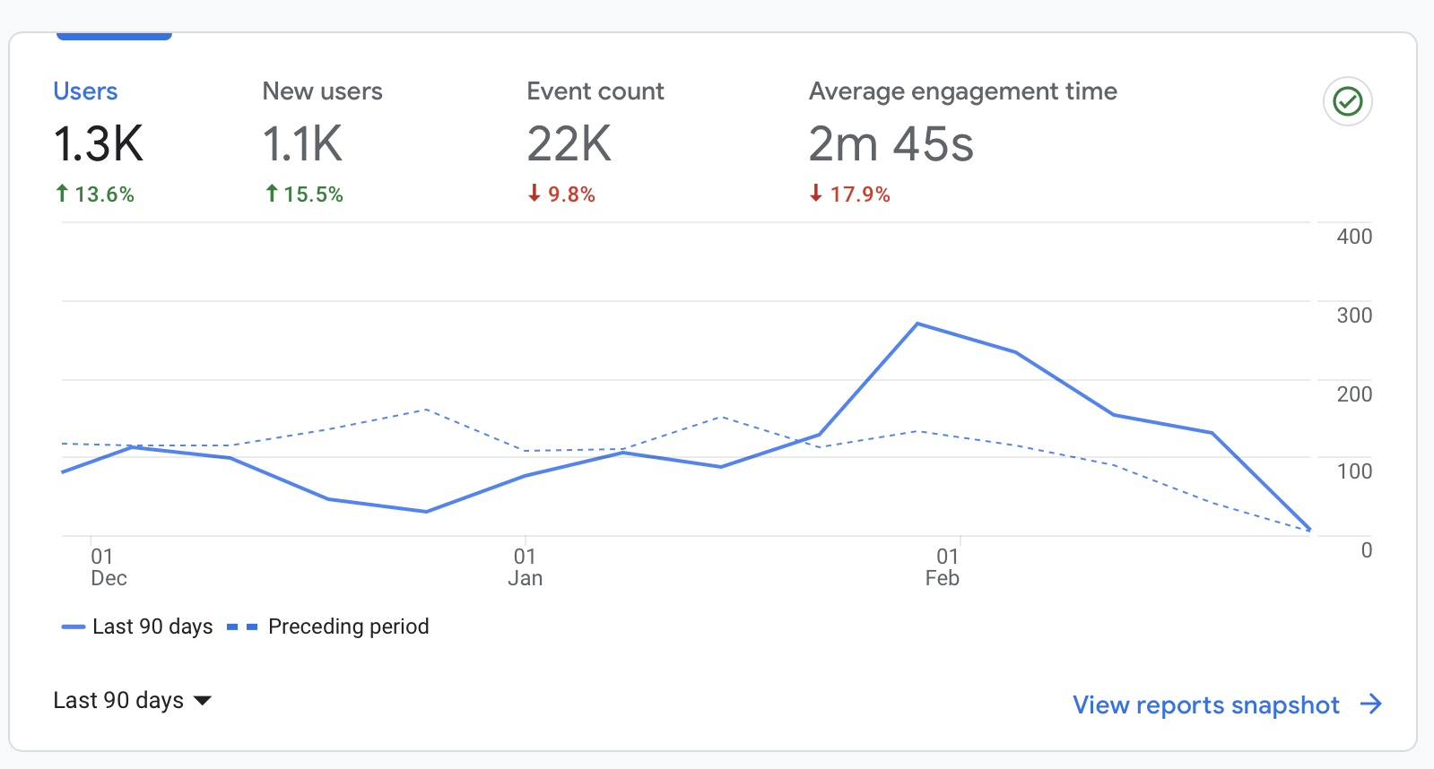
iSOSY Website Analytics
Notes:
We ran analytics for the past 90 days.
We have had more than 1.3K visitors
Most visitors head to the Instructional Resources page, but our student portal page continues to climb. (More on that later).
Personal Wellness Training Package page has the longest average visits.
IF THEY ASK about Bounce Rate - About 50% of visitors leave the site after visiting only one page…that may indicate that they know what they are looking for when they visit the site.

Slide 5
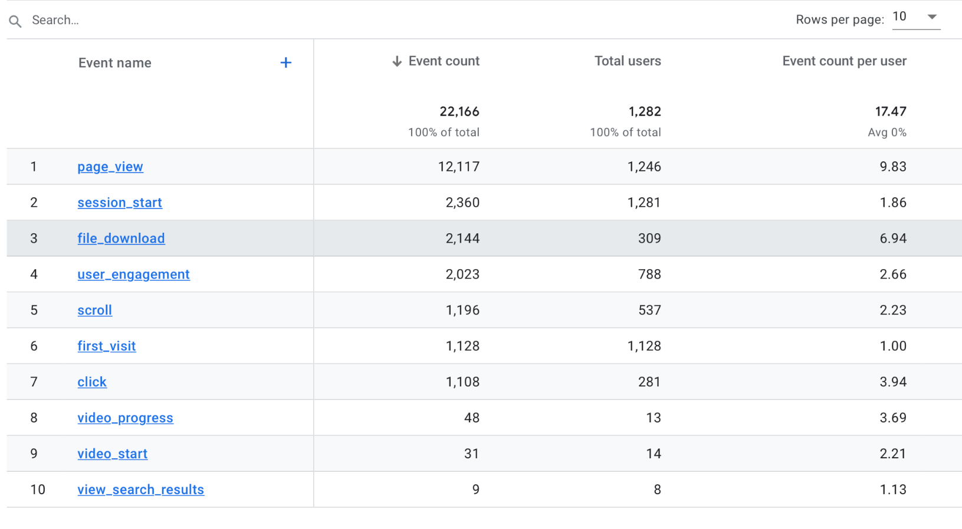
iSOSY Website Analytics
Notes:
Lots of interesting stats here, but the two to point out are:
There have been more than 12,000 page views.
More than 2,100 downloads have occurred from the site in the past 90 days!

Slide 6
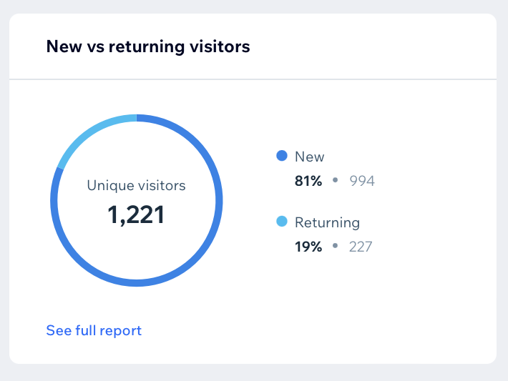
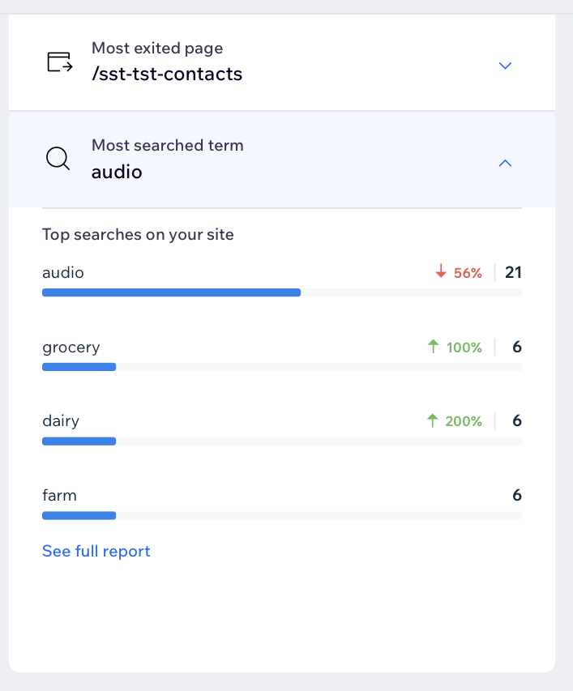
iSOSY Website Analytics
Notes:
During those 90 days we had 1,221 unique (first time) visitors. (Sometimes this means the same person but different browsers or settings.)
We have added 51 new email addresses during this time as well (those are folks visiting the site who elect to enter their email address so we can add them to our listserv.
The search bar continues to be well used with the most searched terms being audio, grocery, dairy, and farm.

Slide 7
Personal Wellness Work Group
Lysandra Alexander (PA - Lead)
Lora Thomas (iSOSY)
Susana Das Neves (IL)
Becca Heine (VT)
Mesha Patrick (AL)
www.osymigrant.org

Slide 8
Personal Wellness
Personal wellness is finding a greater well-being through positively connecting the mind and body. In a simpler sense, achieving personal wellness comes from maintaining a healthy and balanced lifestyle.
www.osymigrant.org

Slide 9
Personal Wellness
Personal Wellness Training Package
SEL: Responsible
Decision-Making
Suicide Prevention
Resilience
Trauma
Trauma-Informed
Best Practices
Self-Care
Mindfulness
Cultural
Responsiveness
ACEs
www.osymigrant.org

Slide 10
Year 3 Work
Book study with TST: “What Happened to You?”
January 12 – Chapters 1-3
February 2 – Chapters 4-6
March 28-29 – Chapters 7-10 within TST Meeting
Dr. Mona Johnson to provide a 3-part webinar series:
January 10 - Fostering Resilient Workplaces: Sustaining Ourselves & Our Staff
February 22 - Social Emotional Learning Strategies for Youth & Adults: A Focus on Skill Building
March 22 - Resiliency and Trauma Recovery
Continue revising materials in the Personal Wellness Training Package

Slide 11
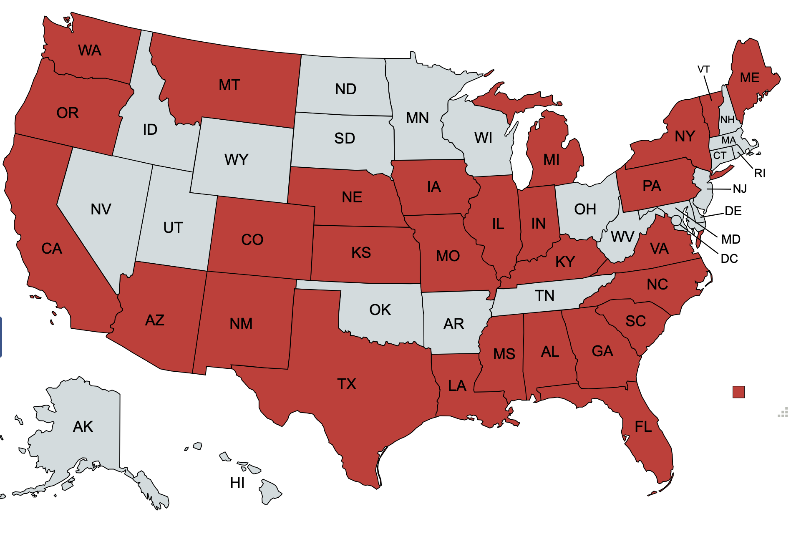
Year 3 Work
Webinar Report
January 10 - Fostering Resilient Workplaces: Sustaining Ourselves & Our Staff
February 22 - Social Emotional Learning Strategies for Youth & Adults: A Focus on Skill Building
Total of 154 attendees from 27 different states!

Slide 12
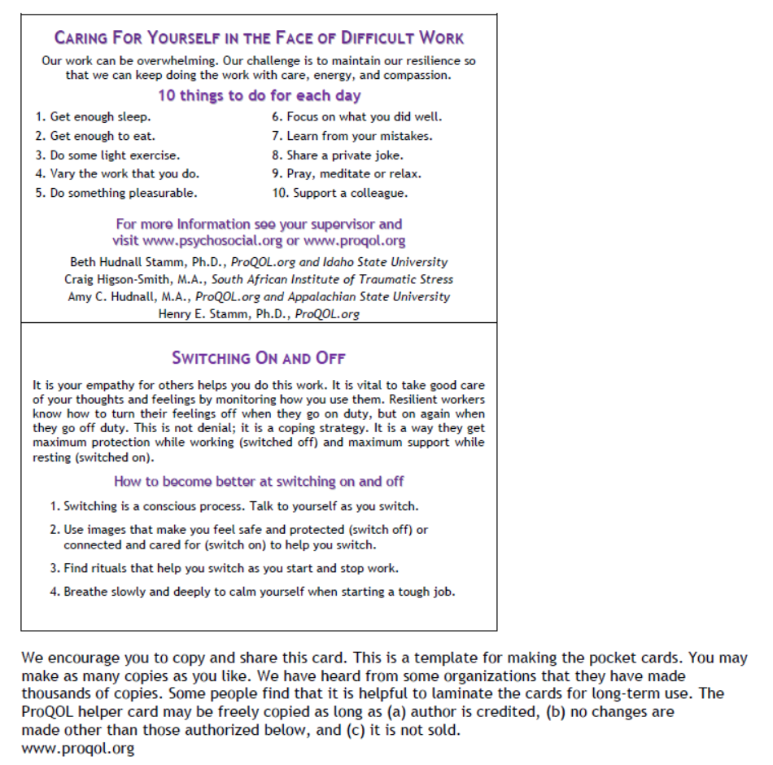
Activity:
The Helper
Pocket
Card
www.osymigrant.org
Notes:
The pocket card was created for service providers to carry as a reminder of how important it is to take care of yourself and those working with you.
The strategies suggested are based on the experiences of other people working in crisis settings and on research from around the world.
The goal is to help improve resilience and increase the positive aspects of helping and reduce the negative ones. In addition, it is designed to promote compassion satisfaction and reduce compassion fatigue, secondary trauma, and vicarious traumatization.
Please feel free to print as many copies as you like and to share this card with others.
Objective:
• To remind service providers of how important it is to take care of themselves
and those working with them.

Slide 13
Professional Learning Work Group
April Dameron (Lead - IA)
Janet Reynolds (KS)
Michelle Mattson (MI)
Hunter Ogletree (NC)
www.osymigrant.org

Slide 14
In the Field: Monthly Resources for the MEP
www.osymigrant.org
Notes:
Question for the group: How many of you remember getting this email? How many of you read it? Forwarded it on?
Our hope is to grow the number of people receiving as well as opening and clicking on the links provided. If you don’t think you received it, check your promotions, that is where many people are finding our newsletter went. These will be sent out each month on the 1st.

Slide 15
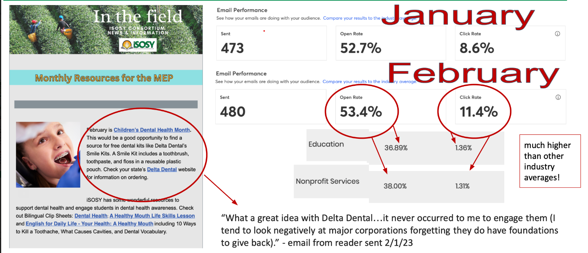
Analytics: In The Field Newsletter
To opt in and receive this newsletter, click the link and add your email address today!
www.osymigrant.org
Notes:
So far we are crushing our goals! Making records with engagement the data shows.
Have had some good feedback about what is being shared!
Please encourage your staff to opt in to receive these monthly newsletters (link above). This info is shareable- please forward info on, add it to your state list serves, etc.

Slide 16
Monthly newsletter topics
Sign up now and don’t miss a month!
Jan: Human trafficking prevention; link to iSOSY Goal Setting
Feb: Dental Health Month; link to iSOSY Relationship Building, Healthy Mouth lesson
Mar: Women’s History Month; link to iSOSY Professional Learning OSY resources
Apr: World Health Awareness Month; link to iSOSY health lessons
May:
June:
www.osymigrant.org
Notes:
Focus is on time of year for recruiting/services & national campaigns relating these back to iSOSY resources. Please share if you have any ideas for future newsletter topics!

Slide 17
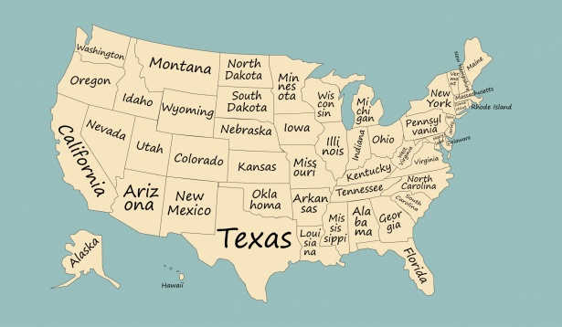
Resource List of Experienced Professionals
Total contacts shared: 16
States submitting someone as a resource:
Iowa
Vermont
North Carolina
Kansas
South Carolina
Georgia
New York
Indiana
Nebraska
Complete the survey now!
Survey
www.osymigrant.org
Notes:
Experts in the field- here is where we are- we have a pretty short list so far and we know we have more talent across our member states. This is what we need to move forward and finalize this project so that can be useful. Who in your state could be a contact for others? Please share with us at least one person from your state that is an experienced professional and could be a resource for others.

Slide 18
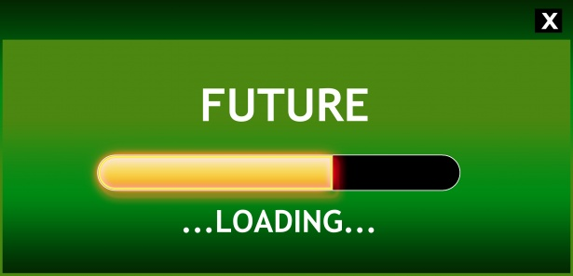
To the future and beyond…
Goals
Spring iSOSY Meeting-
Connect with Professional Development Group
Grow our resource list of experienced professionals across member states
Continue to engage service providers with our monthly newsletters
www.osymigrant.org
Notes:
Don’t forget to share the link to our survey with service providers in your state so we can continue to grow our network of experienced professionals.

Slide 19
Career Awareness Toolkit (CAT Kit)
Members: Adriana Holguin (FSCC), Bianca Fonseca Cervantes (AZ MEP),
Shantella Singleton (PA MEP), and Dr. Zujaila Ornelas (AZ MEP)

Slide 20
Agenda
Purpose of CAT Kit
Introduction to CAT Kit
Next Steps
Questions

Slide 21
- Help service provide and student explore themes that are crucial when thinking about a student’s future - Designed to address one unit or question at a time, based on expressed interests or needs
Purpose of CAT Kit

Slide 22
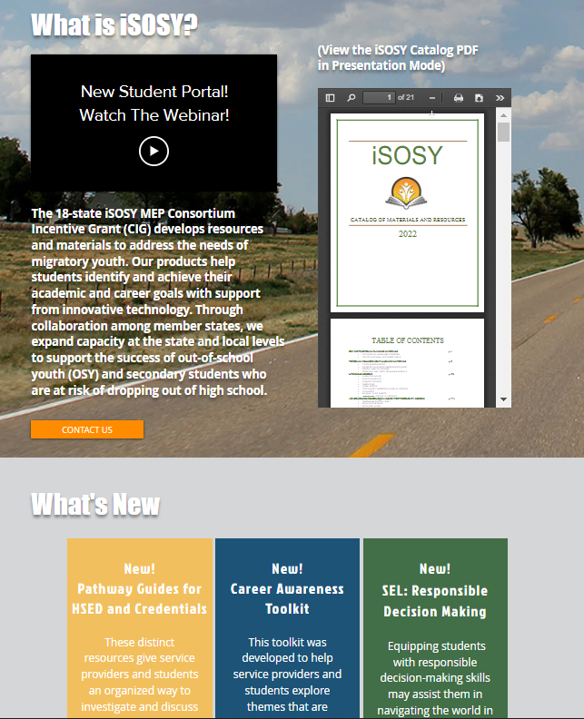
Where can I find the CAT Kit? The CAT Kit can be found on the iSOSY home page or by visiting www.osymigrant.org/career-awareness-toolkit.
Introduction to CAT Kit

Slide 23
Unit Themes - Self Awareness - Goal Setting - Career Awareness - Financial Awareness - Education - Skills and Resources
Introduction to CAT Kit

Slide 24
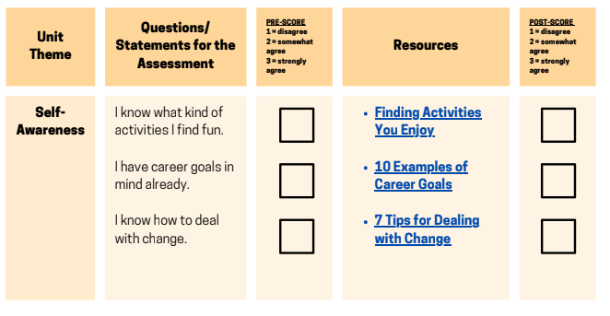
Each Unit Theme contains statements for assessment:
Introduction to CAT Kit

Slide 25
As the Service Provider, you would ask: On a scale from 1 to 3 (1 being disagree and 3 being strongly agree), how would you score the following statement(s)?
Introduction to CAT Kit

Slide 26
As the Service Provider, you would ask, On a scale from 1 to 3 (1 being disagree and 3 being strongly agree), how would you score the following statement(s)?
Introduction to CAT Kit
1

Slide 27
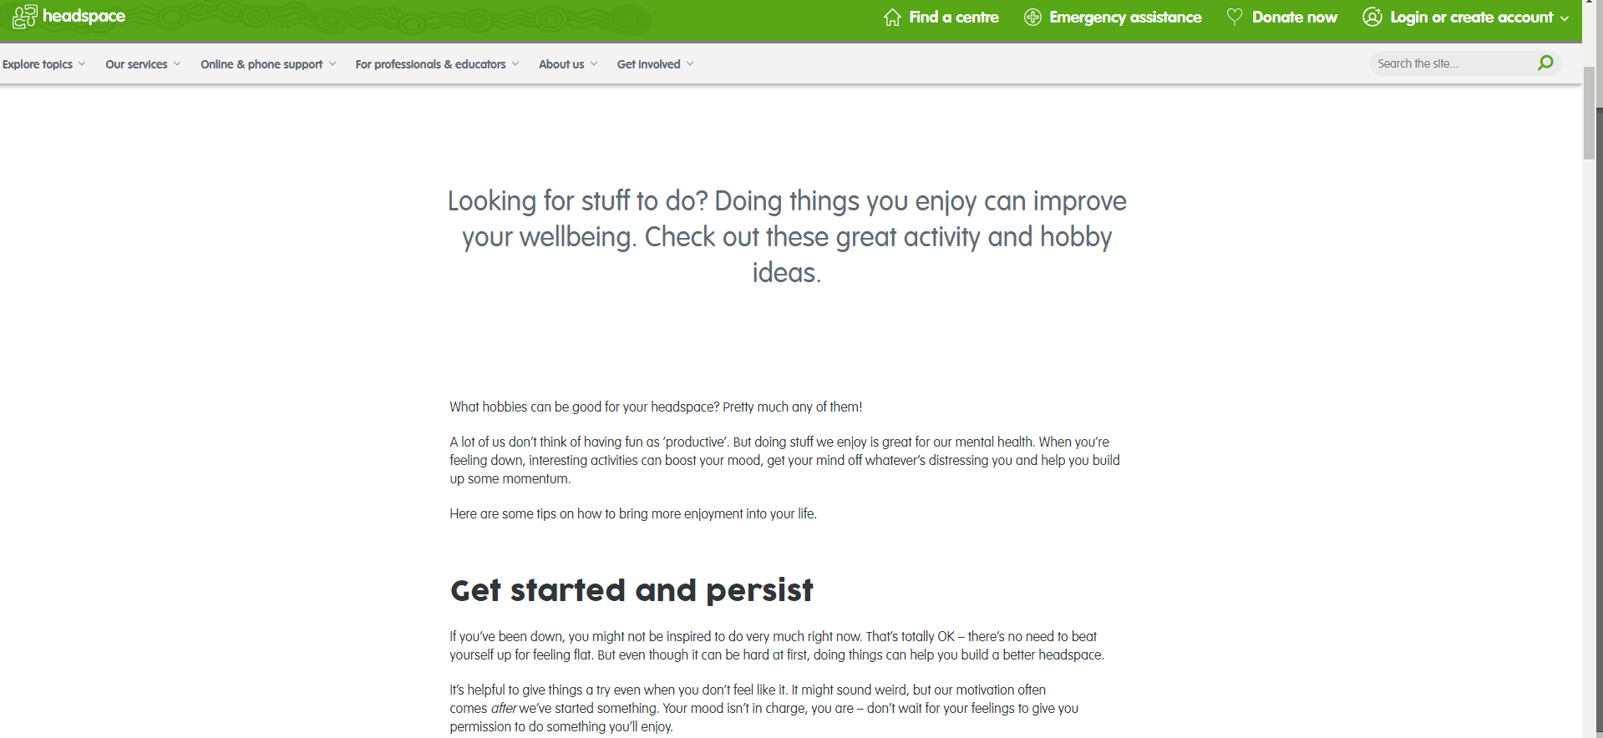
Service Provider reviews resource with student to enhance understanding regarding theme with intent that student will score themselves higher on post-score!
Introduction to CAT Kit
1

Slide 28
As the Service Provider, you would ask, On a scale from 1 to 3 (1 being disagree and 3 being strongly agree), how would you score the following statement(s) after having reviewed this resource?
Introduction to CAT Kit
1
3

Slide 29
The CAT Kit Workgroup will introduce CAT Kit to iSOSY members in April! When: April 12, 2023 Time: 12:00 – 1:00 PM (Central Time) Platform: Zoom Link
Next Steps

Slide 30
Questions

Slide 31
Curriculum and Materials Work Group
Brenda Pessin (Lead)
April Roberts (GA)
Erin Lamboi (IL)
Laurie Stewart (LA)
Wilson Kendrick (MS)
Astrid Poulton (NY)
www.osymigrant.org

Slide 32
Lessons Designed Specifically for
Out-of-School Youth
www.osymigrant.org

Slide 33
STAT Lessons
Short Targeted and Timely (STAT) Lessons
Practical and relevant to the needs and interests of OSY
Designed to be delivered in 45-60 minute sessions
Interactive
Adaptable to setting
In a classroom or out in the field
Longer or shorter relative to available time
Digital and/or print materials
Individually/small group/ large group
www.osymigrant.org

Slide 34
STAT Lessons
STAT Lesson Features
Standard Format
Lesson Plan
Targeted Vocabulary
Interactive Activities
Quizlet
Quia
EdPuzzle
Print and Virtual Worksheets
Videos
Pre- and Post-Tests and Answer Keys
www.osymigrant.org

Slide 35
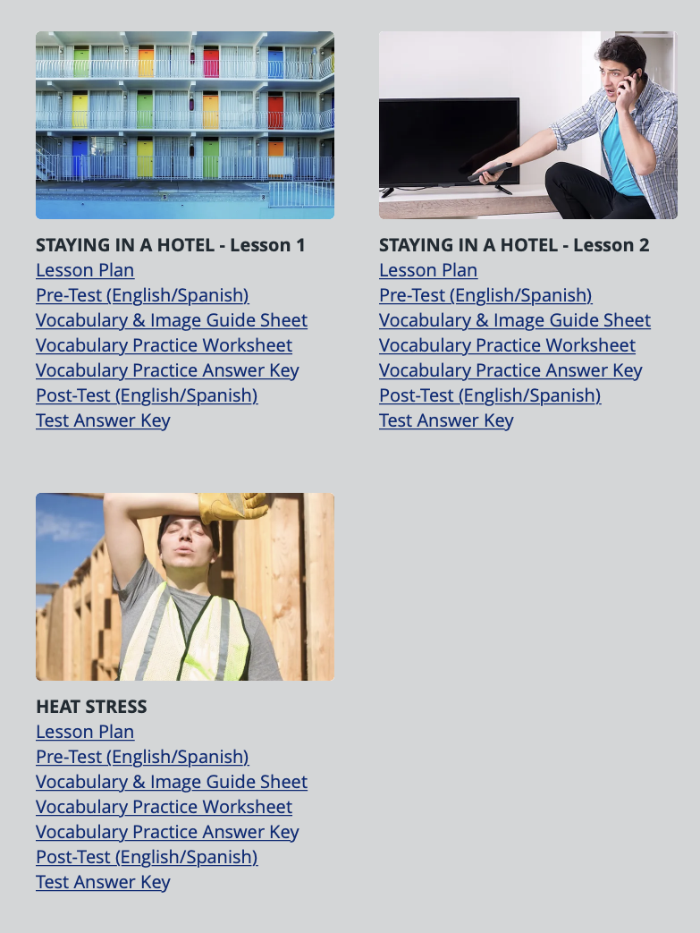
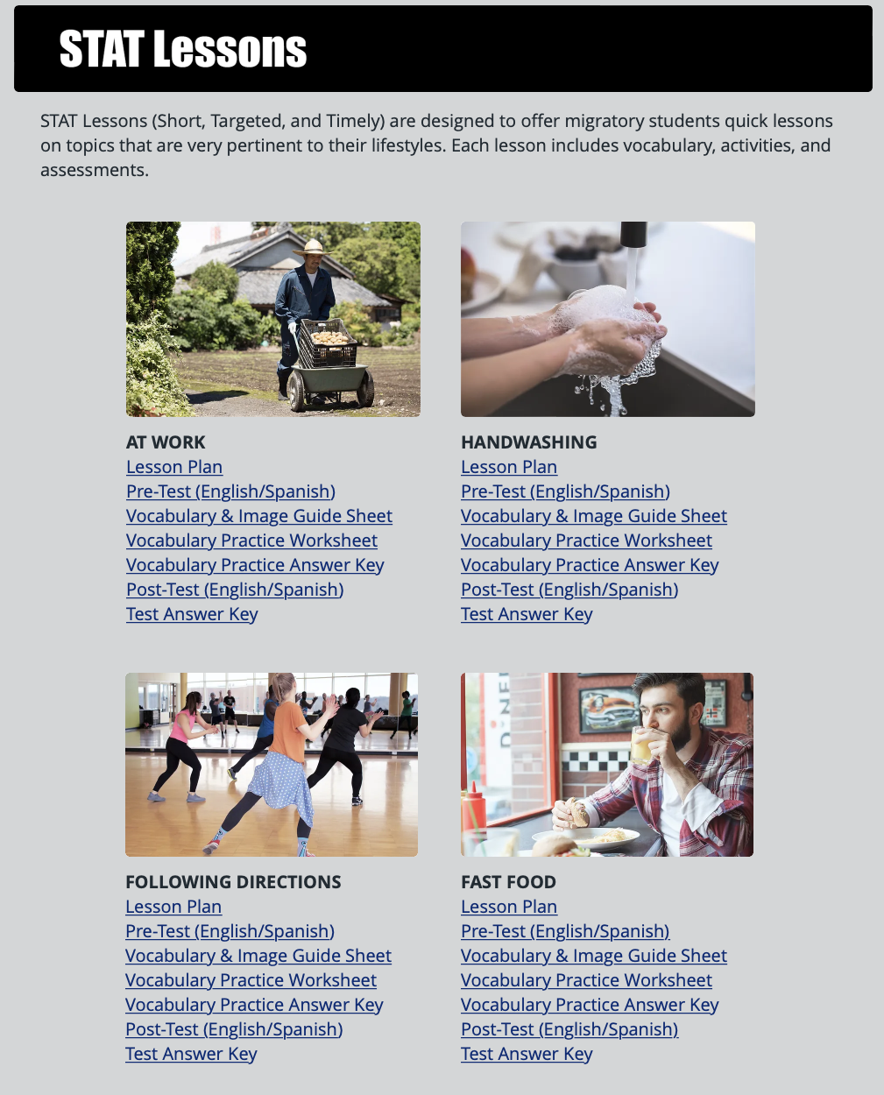
STAT Lessons
Recent STAT Lessons
Heat Stress
Staying in a Hotel 1 & 2
At Work
Handwashing
Following Directions
Ordering Fast Food

Slide 36
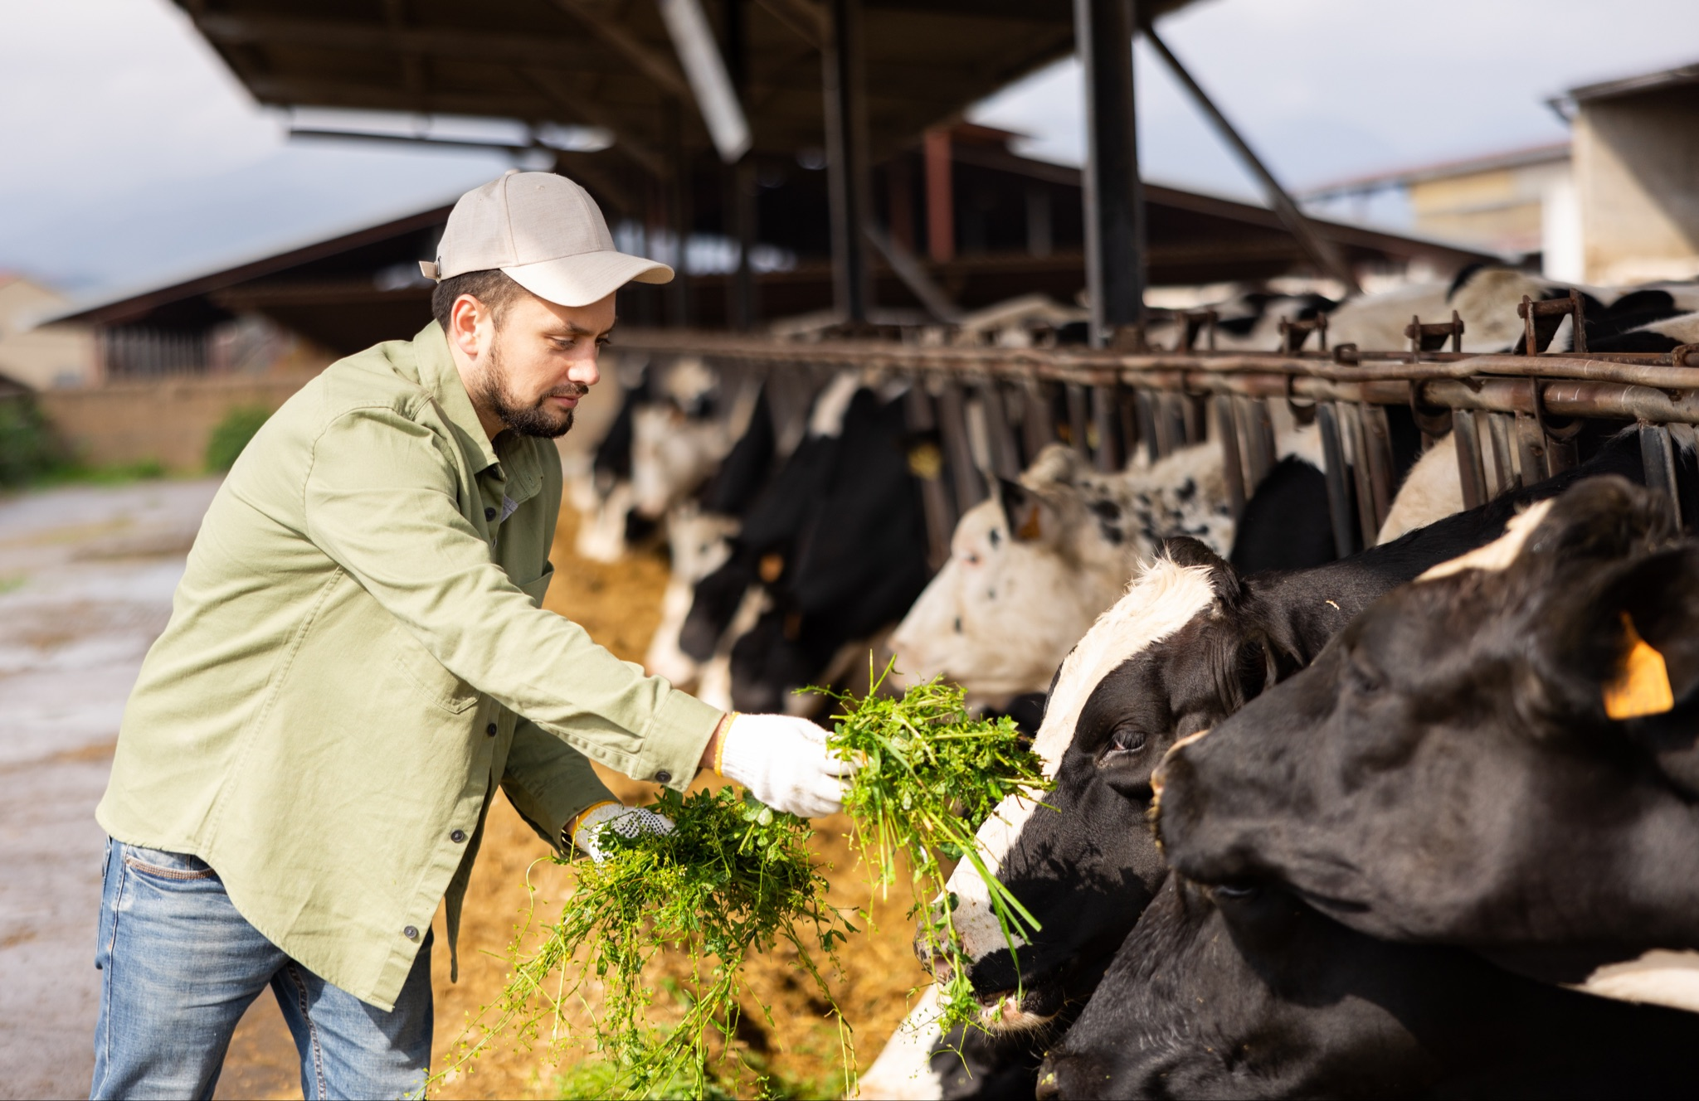
STAT Lessons
STAT Lessons Currently in Progress
Convenience Store and Gas Station (2) (Primary shopping venue for many OSY)
Dairy (2)
Working on a Dairy Farm
Equipment

Slide 37
STAT Lessons
STAT Lesson Enhancements
Revisions to Pronunciation Guides utilizing the Spanish alphabet
Suggested strategies for increasing the level of difficulty of lessons for use with more advanced English learners
www.osymigrant.org

Slide 38
STAT Lessons
Ideas for Future STAT Lessons
Handling Extreme Weather
Preventing Frostbite
Dealing with Sub-Zero Temperature
Do you have additional suggestions for future lessons?
www.osymigrant.org

Slide 39
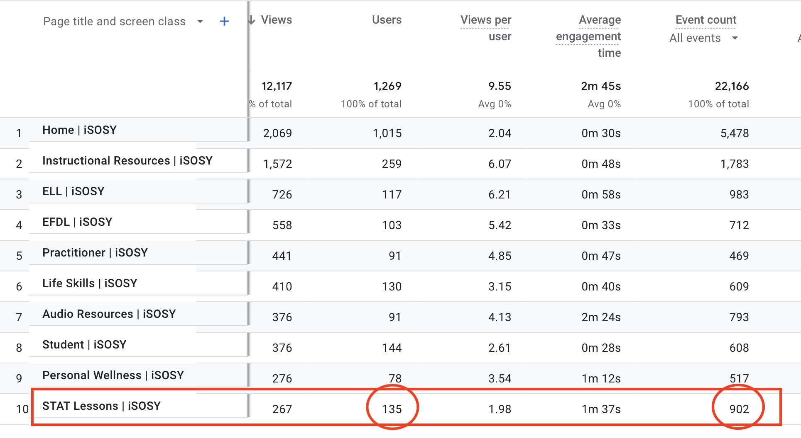
STAT Lessons
STAT Lessons Analytics
Notes:
In the past 90 days, 135 users have opened and/or downloaded STAT Lessons.

Slide 40
Student Portal Work Group
Travis Williamson (NY - Lead)
Andy Wallace (IN)
César Durán (NE)
Iggy Campos (NM)
Bernardo Lopez Casas (NM)
Luis Beltrán (PA)
Carlos Valle (NC)
www.osymigrant.org

Slide 41
iSOSY Student Portal Year 2 Recap
Opening of the Portal
Live Lesson Kickoff
Collected Student Success affidavits
Created Interactive Student STAT Lesson Activities
www.osymigrant.org

Slide 42
iSOSY Student Portal Year 3 Plans
Collaborate with the other teams adding new products to the portal when developed.
Continue the collection of student affidavits mentioning their successes and how the iSOSY materials guided them to success.
Offering more live lessons and revamping the structure of the student portal based on student and educator’s feedback after launching.
www.osymigrant.org

Slide 43
iSOSY Student Portal Year 3 Plans
More Live Lessons to come!
Classes based on areas of student interest:
Survival English (Aug 22)
Work-related phrases
Food/Restaurant Terms
Weather Conditions ( Extreme Cold/Heat)
www.osymigrant.org

Slide 44
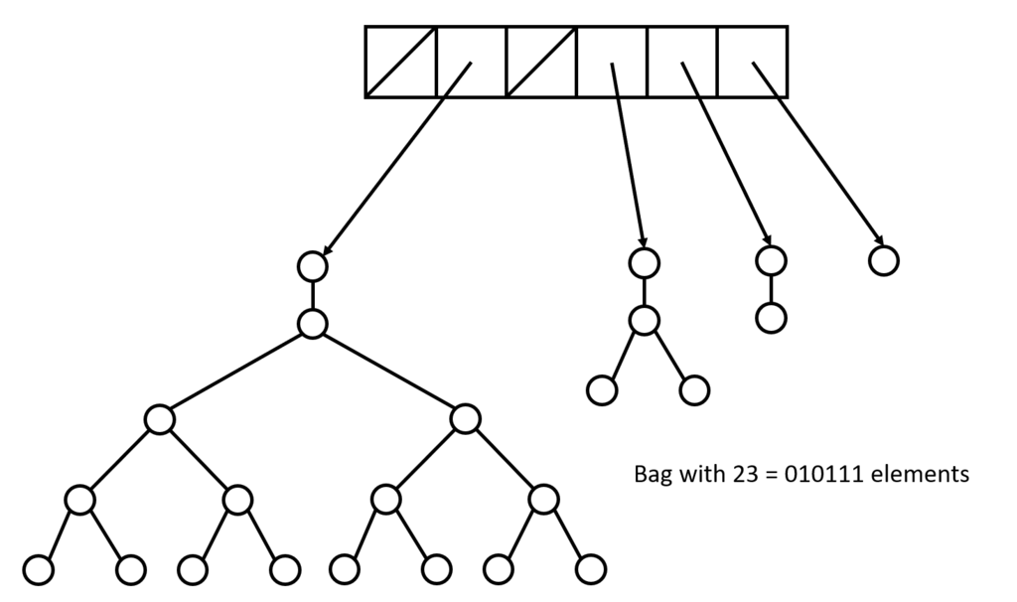
iSOSY Student Portal Year 3 Plans
Currently revamping the structure of the portal based on students needs. The
structure will be accompanied by already created materials and any new materials
createdby work groups from the iSOSY website.
Beginner English Classes (10 Introductory lessons using Simply Speaking Resource)
- Life Skills and Resources
- Catalog of Recorded live lessons and best used lessons
www.osymigrant.org

Slide 45
iSOSY Student Portal Live Lesson
This spring, we will be hosting our second live lesson!
HOLD THE DATE:
MARCH 22 at 7 pm EDT
www.osymigrant.org

Slide 46
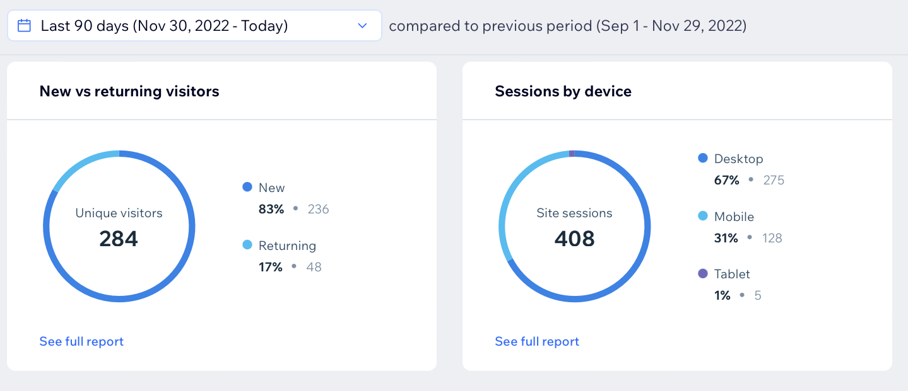
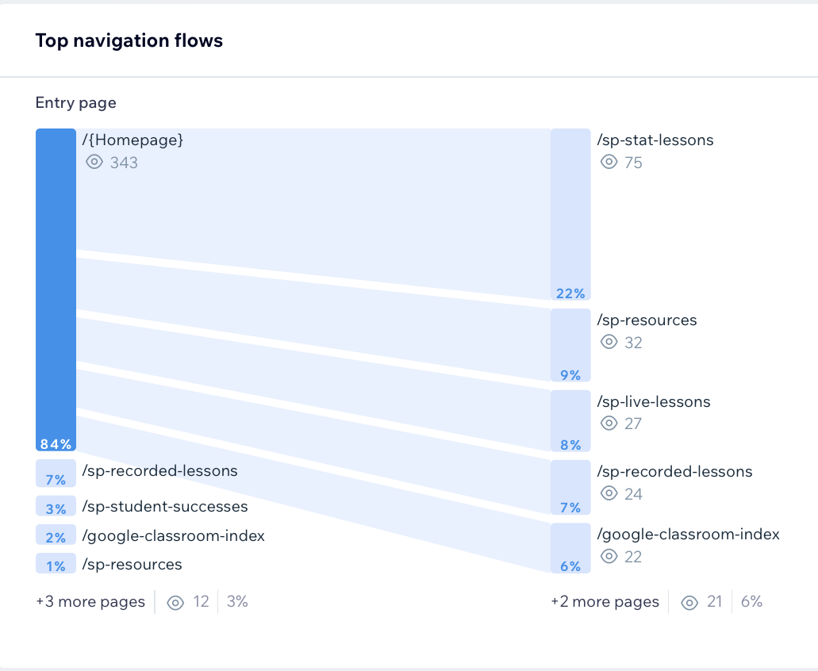
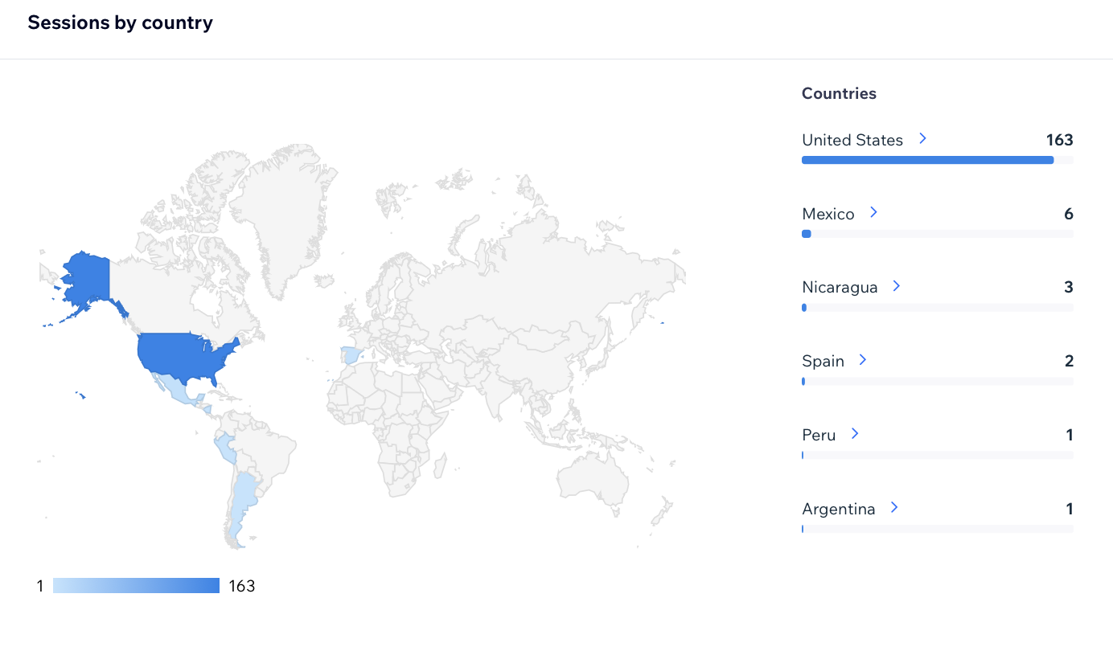
iSOSY Student Portal Analytics
Notes:
In the past 90 days there were 284 new visitors to the Student Portal and a total of 408 site sessions.
The STAT Lessons were the most visited resource.
Interestingly, in the past 30 days we have had visitors from a few different countries…

Slide 47
Pathways Work Group
www.osymigrant.org
This Photo by Unknown Author is licensed under CC BY-SA-NC

Slide 48
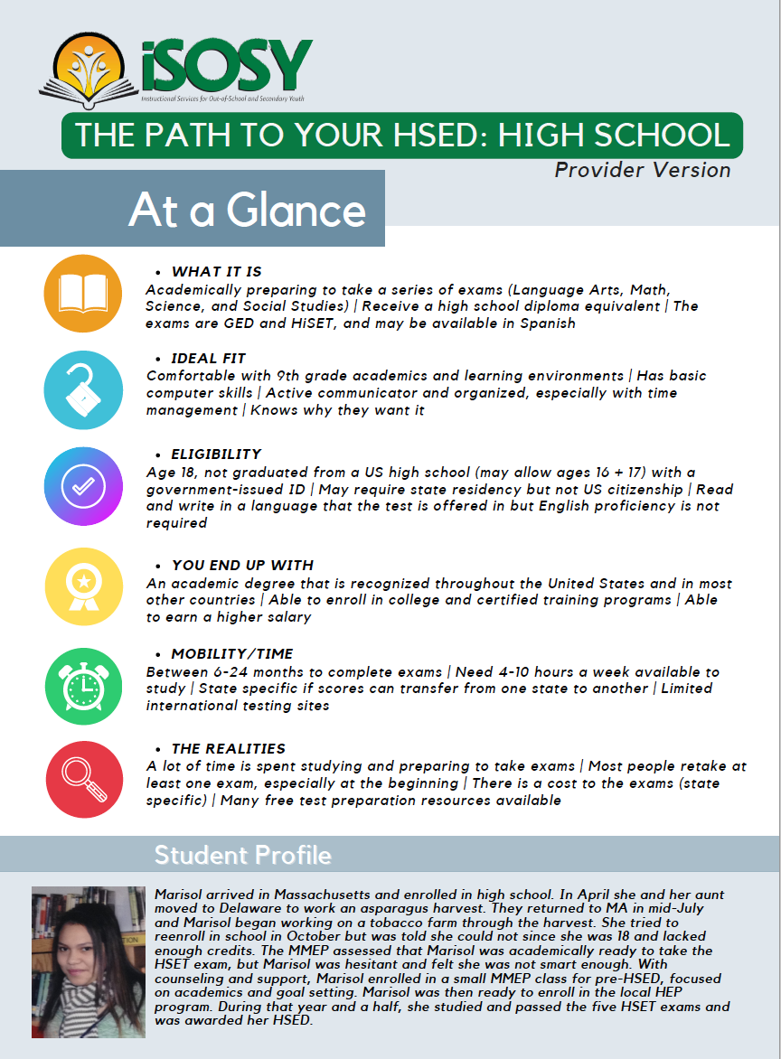
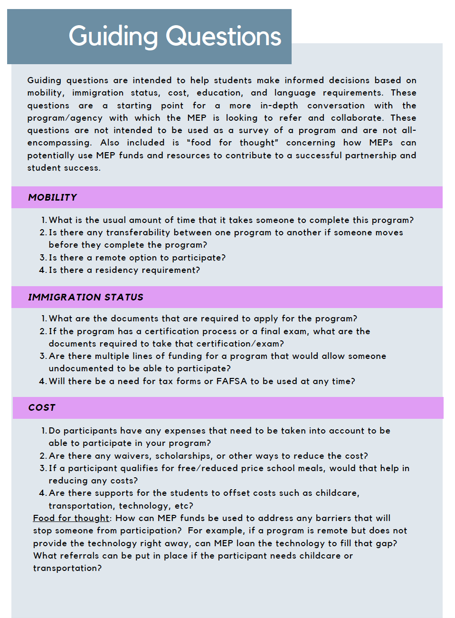
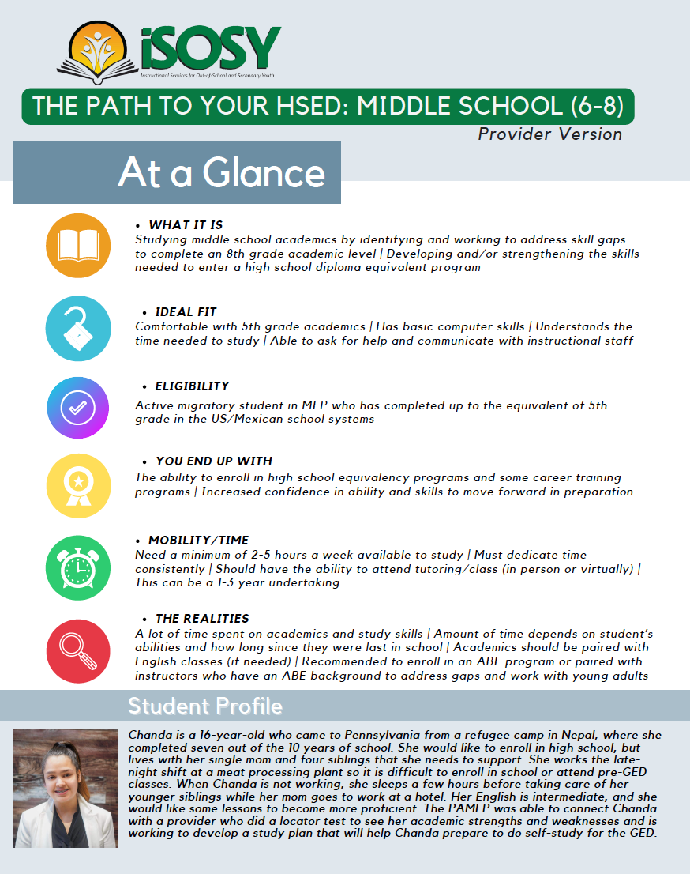
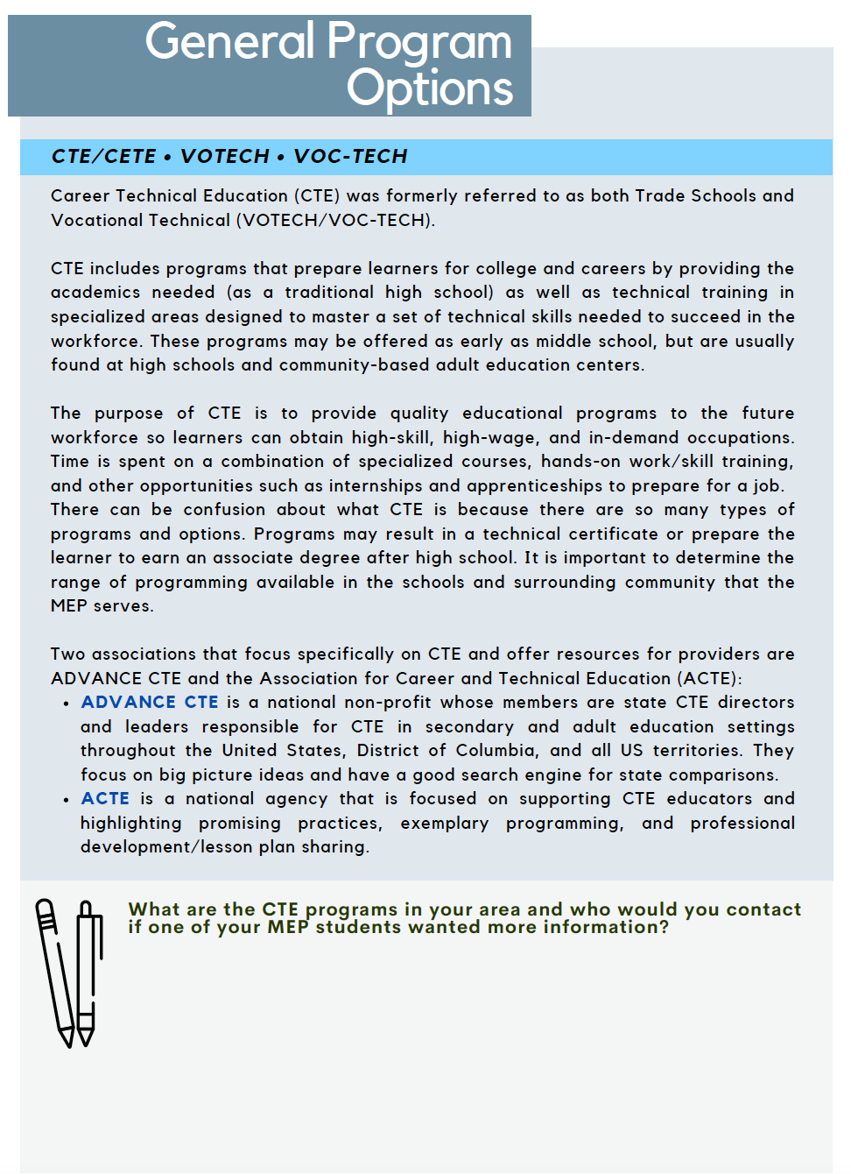
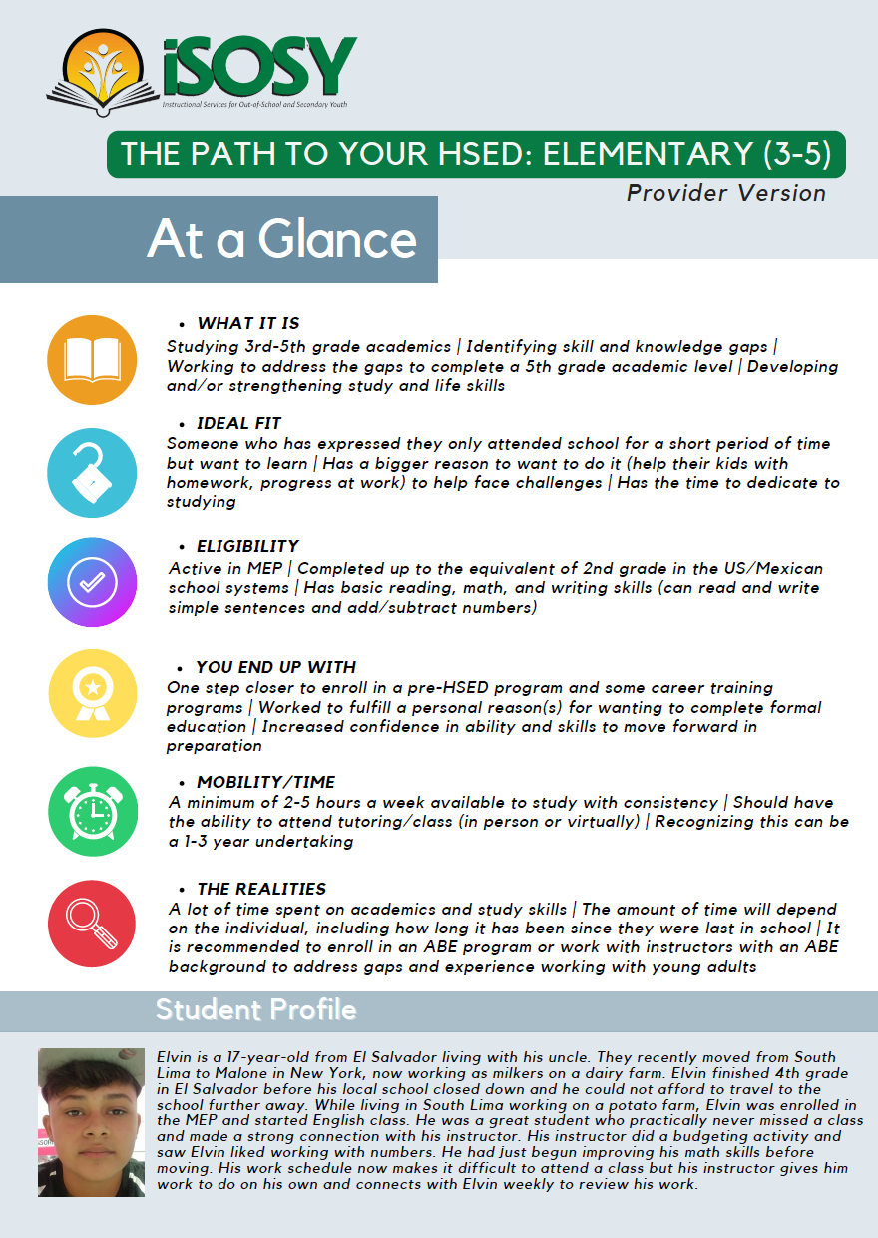
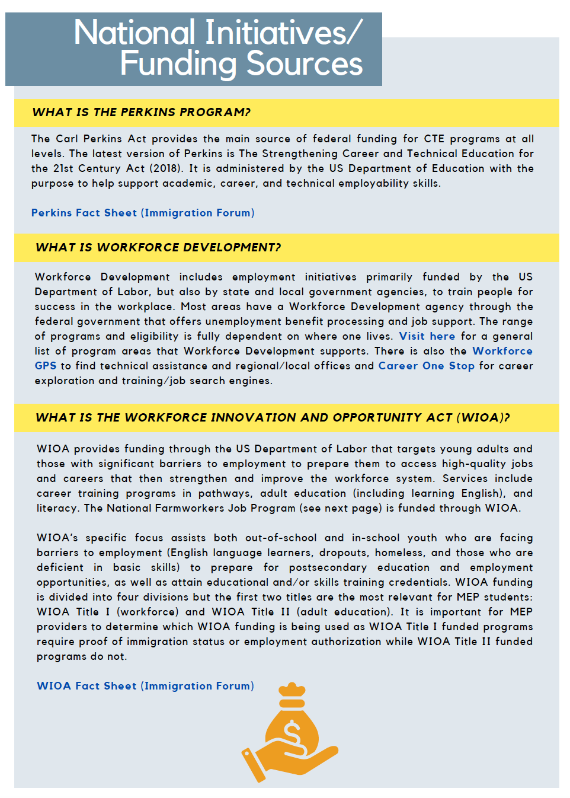
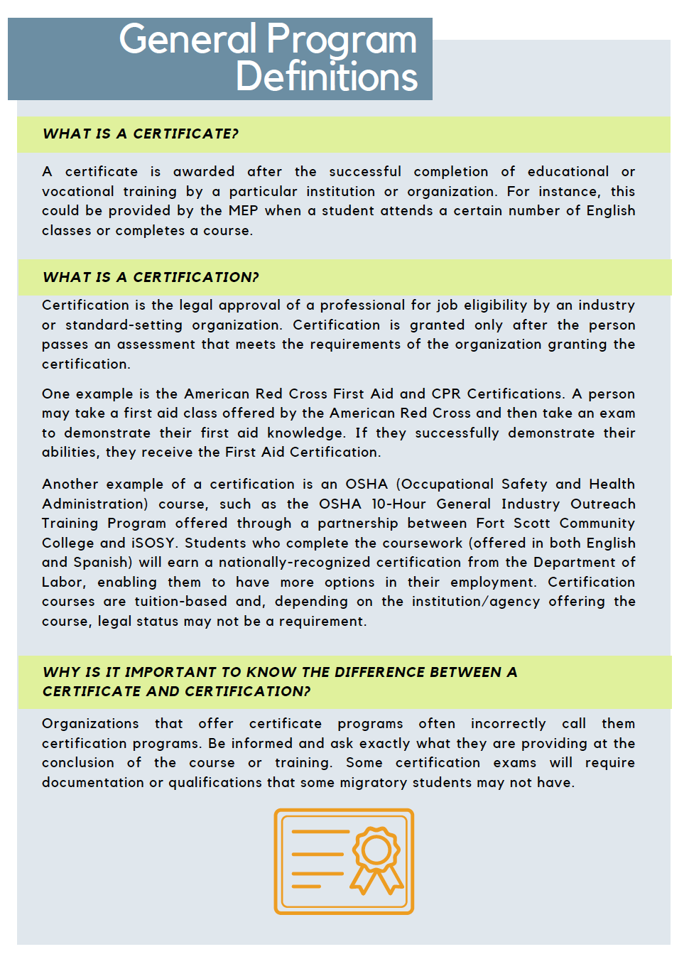
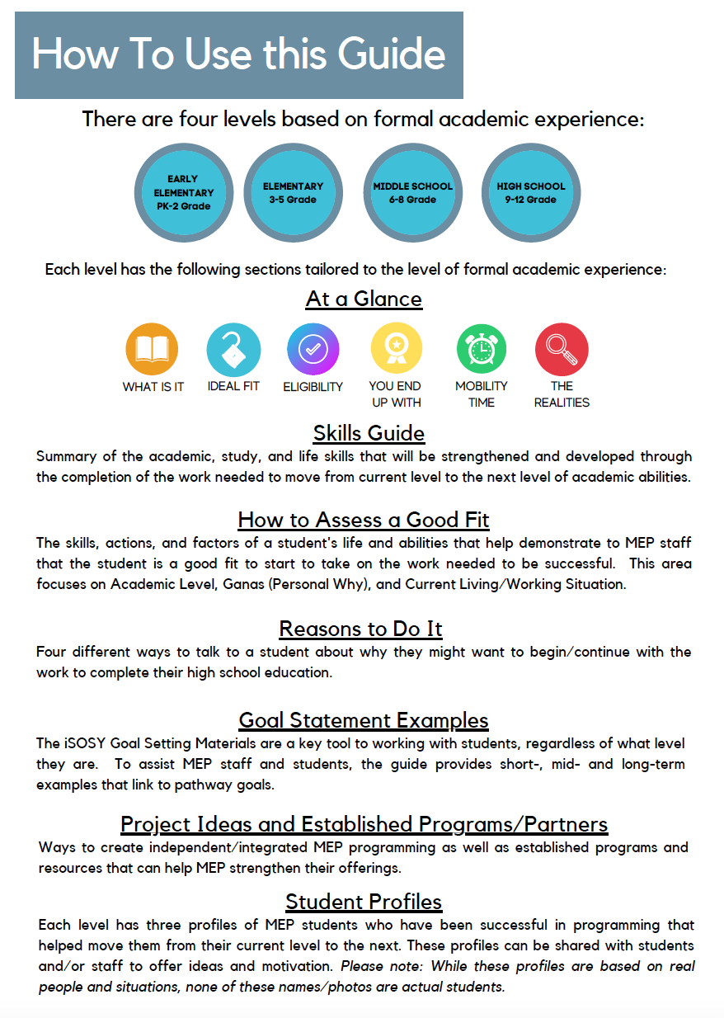
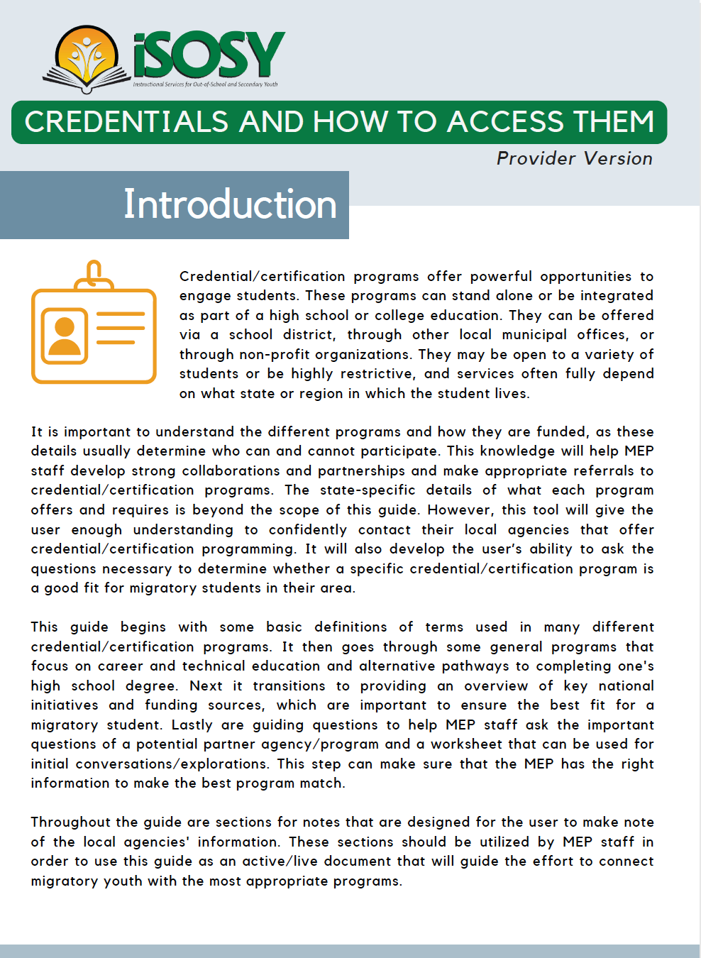
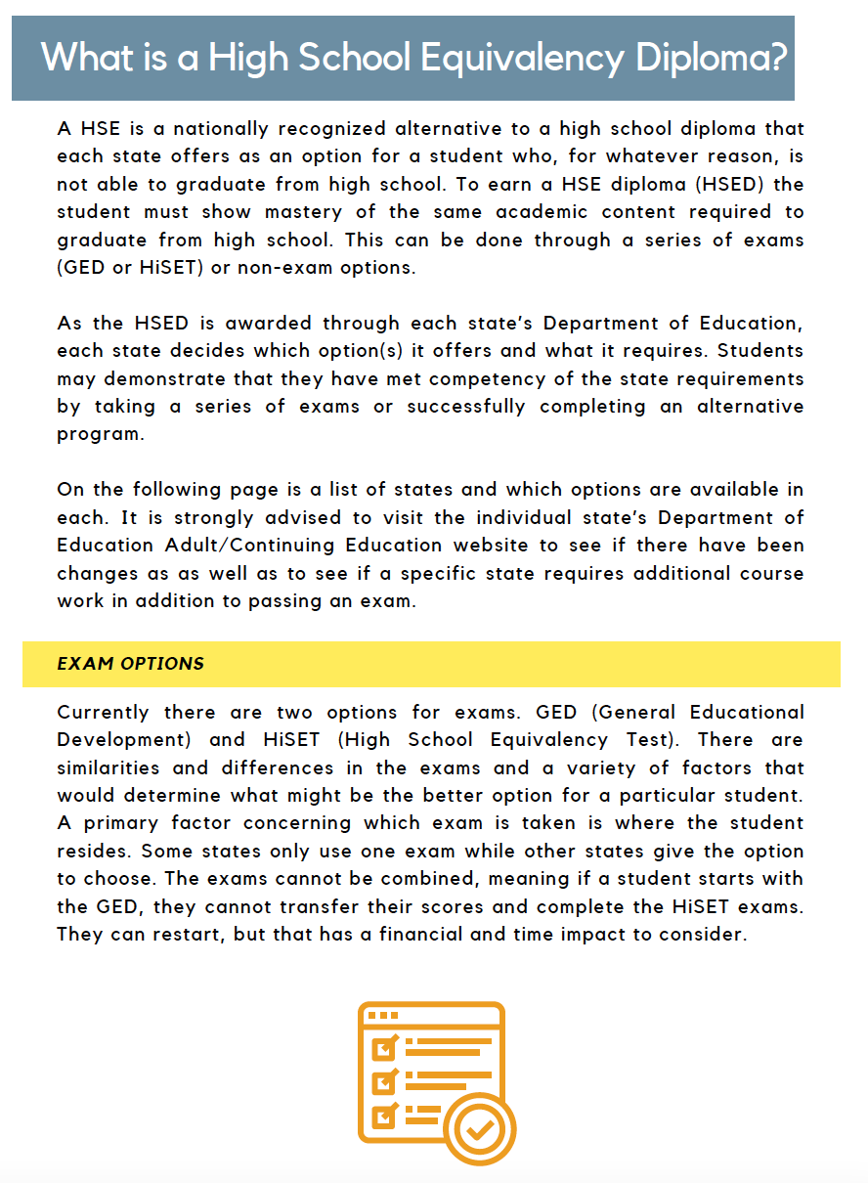
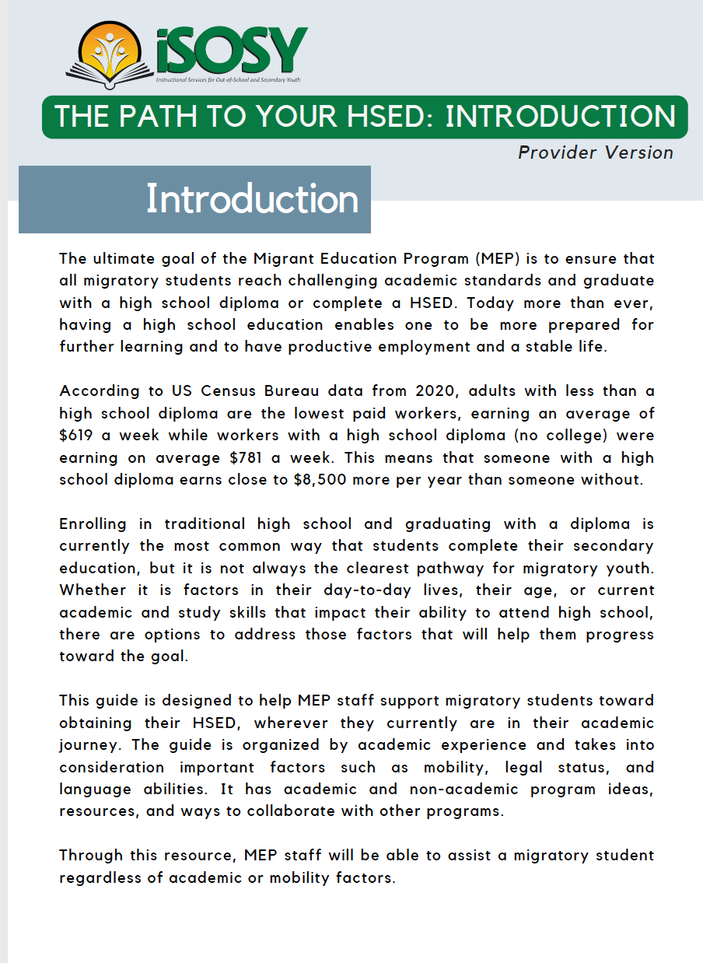
Completed and being used!
CREDENTIALS AND HOW TO ACCESS THEM
THE PATH TO YOUR HSED
www.osymigrant.org

Slide 49
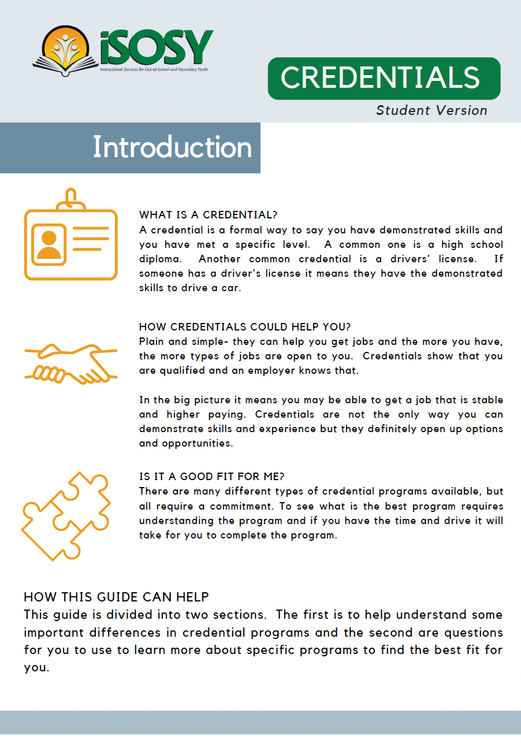
Credentials Student Version
Student Version focuses on two things:
First is:
Building a basic understanding of credentials
What is it?
Credential vs Certificate
Apprenticeship vs Internship
www.osymigrant.org

Slide 50
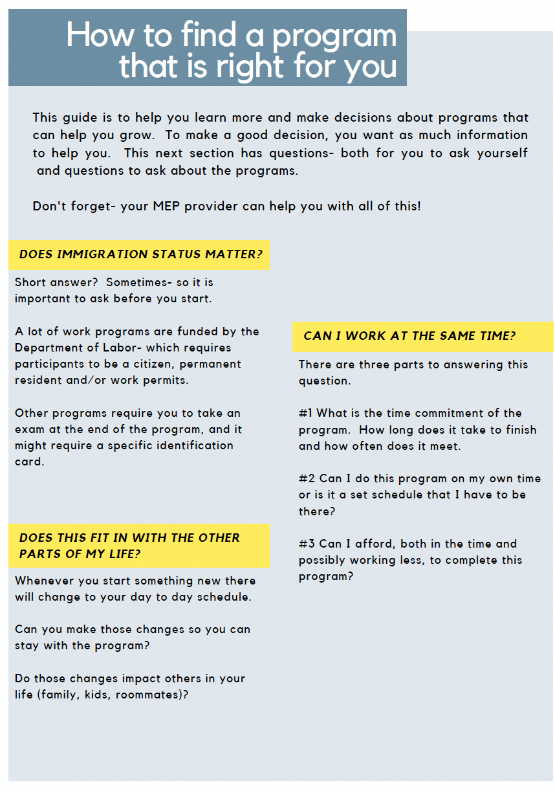
Credentials Student Version
Student Version focuses on two things:
Second is:
Making sure a program is a good fit for you
Things to consider
Immigration Status
Work
Life balance
Information Gathering Worksheet
Important questions to ask of the potential program (and yourself)
www.osymigrant.org

Slide 51
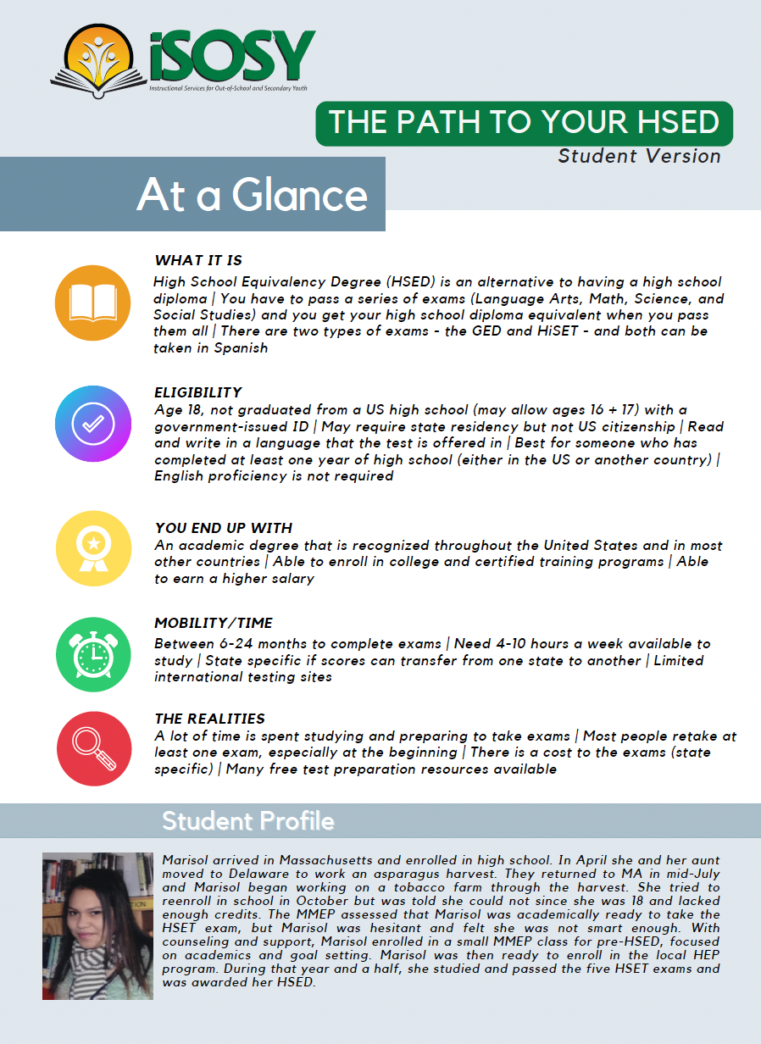
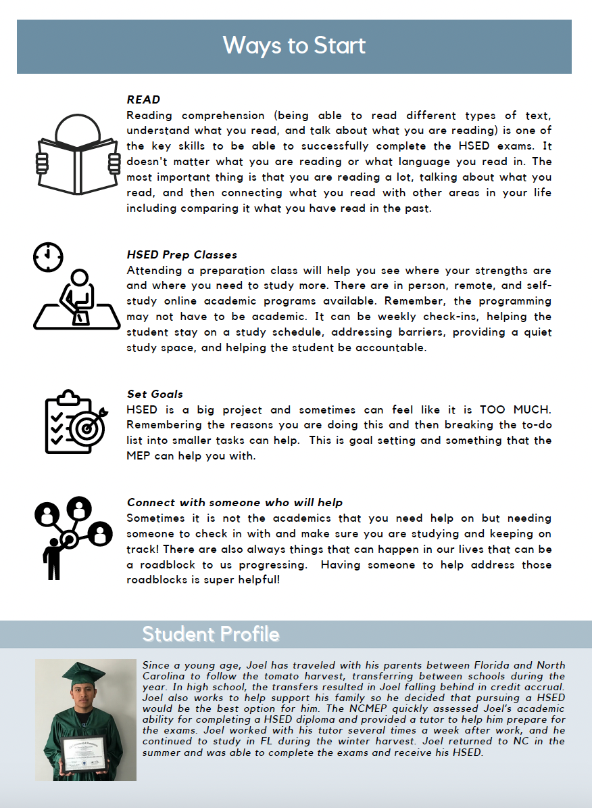
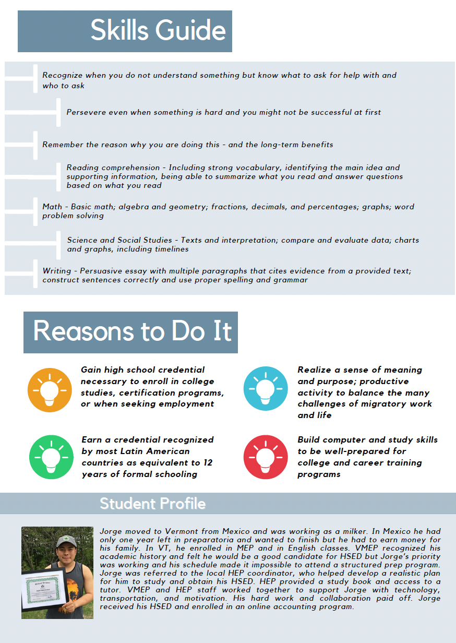
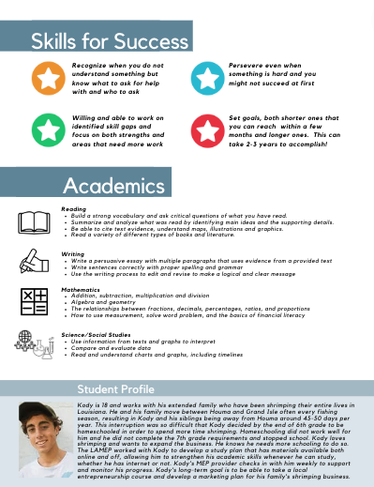
Path to your HSED Student Version
HS + MS Versions
HS + MS Versions
HS Version
MS Version
www.osymigrant.org

Slide 52
CREDENTIALS
Entrepreneurship Course (Needs a Title)
$ Course is made up of a series of slide decks
$ Each slide deck focuses on a specific topic around owning a business
$ Can be used sequentially or by user choice
$ It is designed to provide base knowledge/understanding of what it takes to be successful in starting a business
www.osymigrant.org

Slide 53
CREDENTIALS
Course Design
$ Final version will be able to be used both independently (student goes through slide deck with narration) and in a facilitated format
$ Will be able to be easily used on a computer, tablet or phone
$ Currently in Spanish but can be easily put into English if there is a need/interest
$ MAY have a student workbook if a student is interested in developing their own idea (time/demand dependent)
www.osymigrant.org

Slide 54
CREDENTIALS
Each Part
ASKS
ANSWERS
DEMONSTRATES
REINFORCES
A principal question that is key to being an entrepreneur/business owner
Explains key terms and concepts that are needed
Provides examples- both real and composite that are relatable to migratory student lives.
Concludes with an activity that the participant does to apply the concept that is being taught
www.osymigrant.org

Slide 55
CREDENTIALS
Course Rollout
$ All slide decks will be completed for initial use by the TST this spring
$ The slide deck will have a written script to be used by a provider alongside the student(s) for an instructor-guided use
$ After an initial use and feedback- edits/changes will be made and the script will be recorded for self-guided
$ It is designed to provide base knowledge/understanding of what it takes to be successful in starting a business
$ It is not designed to have the student develop their own business… yet!
www.osymigrant.org

Slide 56
PLC Workgroup
Professional Learning Circle: Intern and Volunteer Program Development
Initial Discussion/Decision
Monthly Meetings
Outcomes
States/programs were invited to participate in a PLC that was going to focus on internship and volunteer programming. Facilitator keeps running notes and helps develop the individual state/program ideas and helps set goals.
Each state/program provides an update of the work they have been progressing on. The group shares ideas, feedback + resources for each other. Each state/program states what are the next action steps they will be taking and working on in the upcoming month prior to the next meeting.
State/program will have progressed on the development of an internship/volunteer program- whatever stage that is in.
Facilitator will use running notes and create a one page ‘case study’ for each project- documenting the process, resources and outcomes of each project- this can then be used by other programs/states as a template/ideas for future program development.
1
2
3
www.osymigrant.org

Slide 57
Year 2 Evaluation Results
www.osymigrant.org

Slide 58
Objective 1 Outcomes
Objective 1: Each year, 70% of migratory OSY and secondary youth at-risk of dropping out who participate in iSOSY instructional support will demonstrate 5% growth on iSOSY curriculum-based assessments.
82% increase in the number with pre/post results!!
 | # Pre/Post-Tested | # Gaining 5% or more | % Gaining 5% or more
Year 1 | 805 | 747 | 93%
Year 2 | 1,551 | 1,353 | 87%
WOW!!
www.osymigrant.org

Slide 59
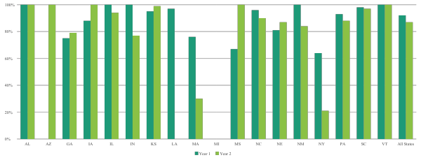
Percent Increasing by State
www.osymigrant.org

Slide 60
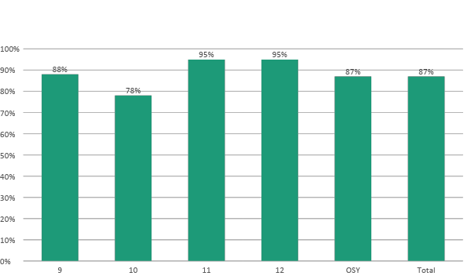
Objective 1 by Grade
www.osymigrant.org

Slide 61
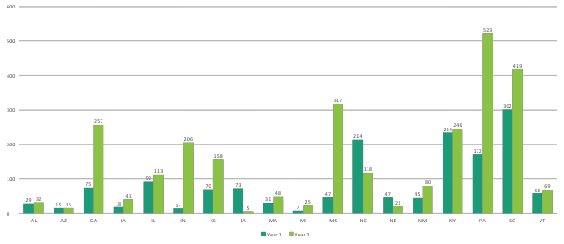
Using iSOSY Materials
Number using iSOSY materials went from 1,543 (Y1) to 2,693 (Y2), a 75% increase! WOW again!!
www.osymigrant.org

Slide 62
Output 1a: Instructional Services
Grade | Year 1 |  |  | Year 2
 | # Identified | # Served | % Served | # Identified | # Served | % Served
At-risk secondary | 3,640 | 1,899 | 52% | 4,983 | 2,687 | 54%
OSY | 6,946 | 3,819 | 55% | 8,380 | 5,031 | 60%
Total | 10,586 | 5,718 | 54% | 13,363 | 7,718 | 58%
Number identified increased by 2,777 and number receiving instruction increased by 2,000. The percent served also increased. Triple WOW!
www.osymigrant.org

Slide 63
Output 1b: Learning Plan Progress
Grade | # With a learning plan | # Making progress | % Making progress
9 | 171 | 118 | 69%
10 | 102 | 70 | 69%
11 | 79 | 57 | 72%
12 | 42 | 37 | 88%
OSY | 606 | 509 | 84%
Total | 1,000 | 791 | 79%
www.osymigrant.org

Slide 64
Objective 2
Objective 2: By the end of Year 3, iSOSY States will support 144 migratory youth (average increase of 3 per state over baseline) to obtain an HSED or regular high school diploma.
 | Year 1 | Year 2 | Needed Year 3
Completed HEP or other HSE program | 7 | 26 | 35
Graduated after reenrolling or from an alternative HS | 9 | 28
Earned HSED | 18 | 21
Total | 34 | 75
That’s a 121% increase!!
Aren’t you all tired of WOWing me yet?!?
www.osymigrant.org

Slide 65
Objective 2: Measurable Outputs
Number enrolled in HSED programs: 85
Number enrolled in credential/certificate program: 56
Enrollment in credit accrual: 106
Reenrollment in high school: 93
Number of at-risk secondary students who graduated: 369
www.osymigrant.org

Slide 66
Objective 3 Data
Objective 3: By the end of Years 2 and 3, 80% of staff participating in iSOSY professional development (PD) will increase knowledge and understanding of strategies to promote graduation and attainment of postsecondary credentials appropriate for the needs of their students.
Item | N | No increase | Not much increase | Somewhat increased | Increased | Increased a lot | % increased+
To what extent did this training help increase your knowledge and understanding of pathways toward graduation or credentials? | 23 | 0 (0%) | 0 (0%) | 1 (4%) | 10 (43%) | 12 (52%) | 95%
www.osymigrant.org

Slide 67
Training Survey Results
Venue | N | Relevance | Applicability | Participation | Materials | Facilitators
Local or State Training | 137 | 2.9 | 2.9 | 2.8 | 2.9 | 2.9
iSOSY Webinars | 204 | 2.9 | 2.9 | 2.7 | 2.8 | 2.8
All | 341 | 2.9 | 2.9 | 2.8 | 2.9 | 2.8
A three-point scale where 1=Developing, 2=Good, 3=Excellent
www.osymigrant.org

Slide 68
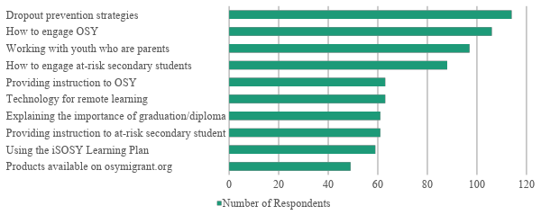
Training Topic Suggestions
www.osymigrant.org

Slide 69
Objective 3: Measurable Outputs
341 Surveys completed
7 iSOSY virtual trainings for 213 participants
160 state and local trainings for 2,361 participants
www.osymigrant.org

Slide 70
Training Survey Results
Did training increase your knowledge and understanding of iSOSY materials and strategies? | N | No increase | Not much increase | Somewhat increased | Increased | Increased a lot | % increased+
iSOSY Webinars and Training | 132 | 0 (0%) | 0 (0%) | 8 (6%) | 61 (46%) | 63 (48%) | 94%
Local or State Training | 119 | 0 (0%) | 1 (1%) | 16 (13%) | 53 (45%) | 49 (41%) | 86%
All training | 251 | 0 (0%) | 1 (<1%) | 24 (10%) | 114 (45%) | 112 (45%) | 90%
www.osymigrant.org

Slide 71
Additional Analysis
Number of student/OSY reported as receiving instruction is much higher than the number reported as using iSOSY materials:
7,718 all students/OSY received instruction
2,693 all students/OSY used iSOSY materials
5,031 OSY received instruction
2,246 OSY used iSOSY materials
How are the approx. 2,800 OSY who did not use iSOSY materials receiving instruction?
www.osymigrant.org

Slide 72
Pilot Review Form Results
The TST reviewed results of the pilot implementation and made updates to materials based on the results.
Contact Marty if you would like the Pilot Review documents.
www.osymigrant.org

Slide 73
Dig into State Data
All states have a summary of the data provided for the annual reports for Years 1 and 2.
These reports may be useful for MEP CNA or evaluation.
If you need a copy of your report, contact Marty.
www.osymigrant.org

Slide 74
Progression of Activities and Objectives
Year 1: Development of new products and procedures
Year 2: Pilot test new products in at least 3 states and revise
Year 3: Offer new products consortium wide
Existing products (such as Learning Plans and Life Skills Lessons) should be used throughout all three years.
Develop
Pilot
Offer
www.osymigrant.org

Slide 75
Year 3 Overview
www.osymigrant.org

Slide 76
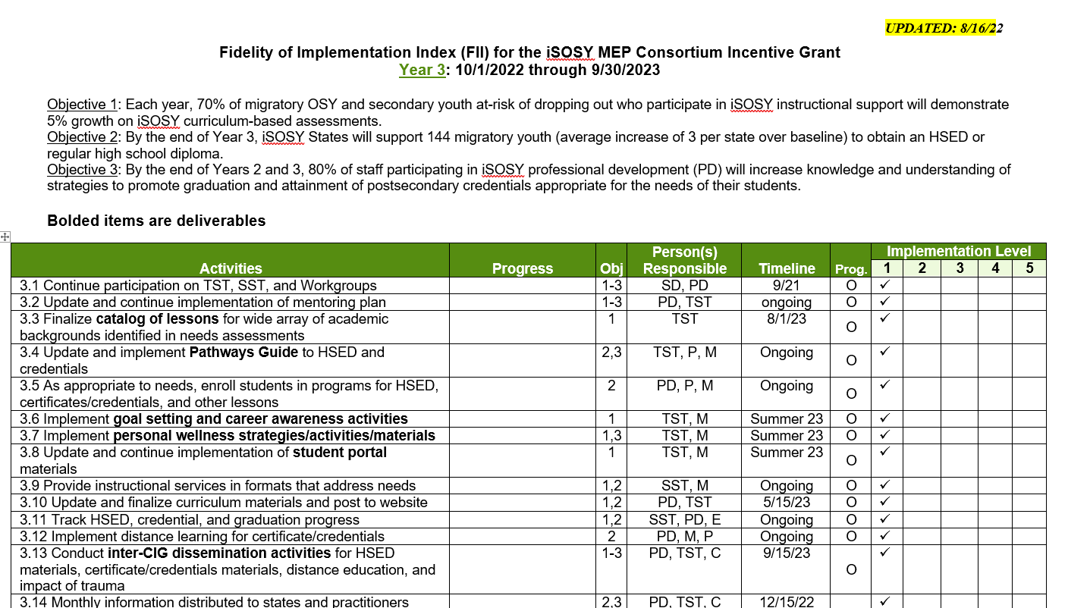
Year 3 FII Review
Fidelity of Implementation Index (FII)
Used to rate progress on activities we proposed
www.osymigrant.org

Slide 77
New to the FII
Year 3 is about implementation and use of products
Year 3 will be the final year for reaching Objective 2 (assisting students in obtaining an HSED)
Dissemination event will be virtual and in conjunction with the other CIGs
www.osymigrant.org

Slide 78
Data Collection Changes
Form 1: Director/Coordinator Report has one additional question about use of products (see next slide)
Form 2: iSOSY Training Survey (tweaked—new link and QR code)
Form 3: Pilot Review Form: this form will only be used if we have new products (such as the live lessons) and is optional
Form 4: Graduation, HSED, and credential support training survey (will be for select iSOSY webinars only to address Objective 2)
IMPORTANT: Final versions are on the Administrator Data Collection area of the website.
www.osymigrant.org

Slide 79
Year 3 Implementation
New question added to the Director/Coordinator report.
It’s not necessarily required but we would like each state to commit to using at least one product in Year 3.
6. Which product(s) were used in your state?
☐Goal Setting and Career Awareness Toolkit ☐Secondary student profile
☐Personal Wellness materials ☐Pathways Guide
☐Live lessons ☐Student Portal
☐Website tour ☐STAT Lesson: _____________________
☐ OSHA certification
www.osymigrant.org

Slide 80
Form 1: Director/Coordinator
Complete once for each state
Summarizes data collected regarding iSOSY services and activities
What questions do you have?
www.osymigrant.org

Slide 81
Form 2: Staff Training Survey
Complete following training that includes iSOSY strategies or information.
You may submit these to the evaluator at any time.
File is available for download or you may use the online survey.
www.osymigrant.org

Slide 82
Form 3: Pilot Product Review
OPTIONAL
Will be customized for materials being piloted in Year 2 at the TST meeting.
You may submit these to the evaluator at any time.
May not be applicable to all states depending on the pilot schedule.
www.osymigrant.org

Slide 83
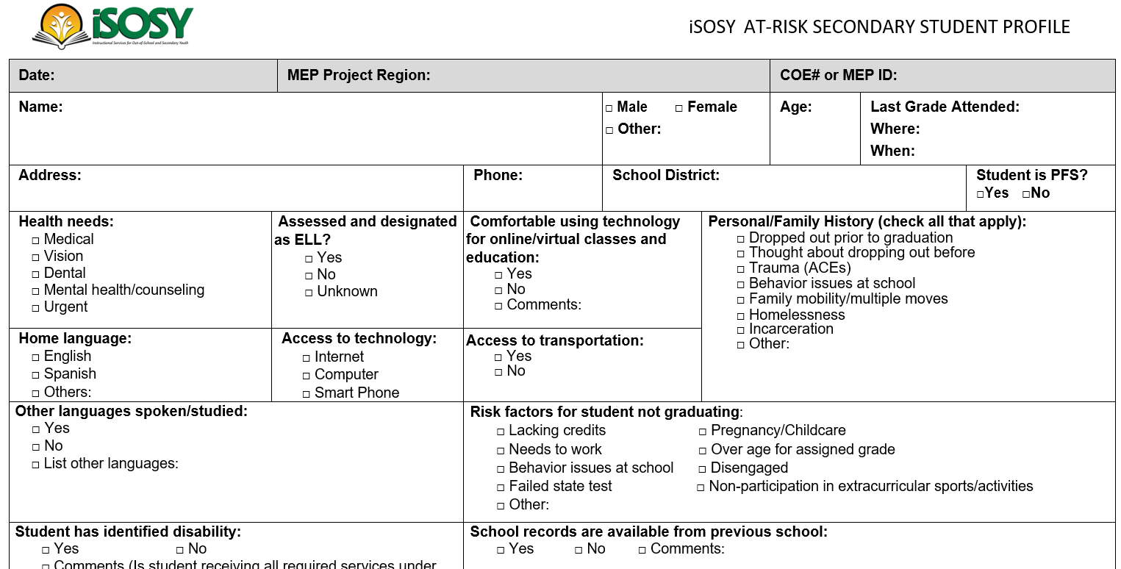
Profiles
OSY Profile and Summary
Used for CNAs in many states
Also used to guide material development and CIG proposals
Secondary student profile
The secondary student profile is a tool available to identify the needs of secondary students and help guide instructional staff toward appropriate materials for the student.
We will not be collecting data at the consortium level for this form. States may choose to use it for Comprehensive Needs Assessment or other state data collection.
www.osymigrant.org

Slide 84
Form 4: Pathways to Graduation or Certificates
Asks specifically about pathways to graduation, credentials, or certificates
Will be used with select iSOSY trainings
www.osymigrant.org

Slide 85
Evaluation and Profile Data Meeting
March 14 at 2:30 (East), 1:30 (Cent), 12:30 (Mount)
We will go over data needed for Year 3 in more detail.
Those responsible for collecting iSOSY data are encouraged to attend.
www.osymigrant.org

Slide 86
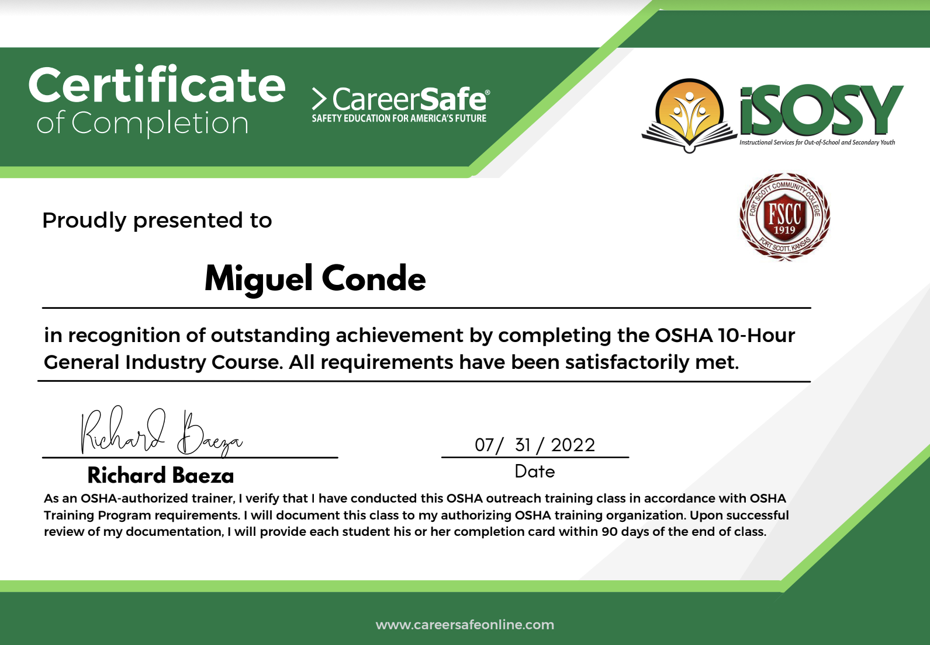
OSHA Course - Spring 2022
Arizona - 2
Indiana - 1
Iowa - 1
Kansas - 1
Massachusetts - 2
Mississippi - 1
New York - 1
North Carolina - 2
Pennsylvania - 4
7 students completed the course and earned certificates.
www.osymigrant.org
Notes:
15 students from 9 states.

Slide 87
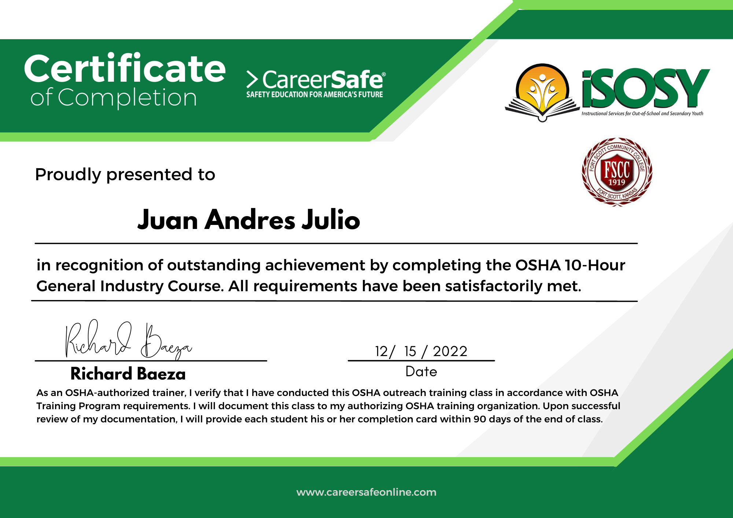
OSHA Course - Fall 2022
Arizona - 2
Georgia - 4 (1 student)
Illinois - 2
Iowa - 2 (1 student)
Louisiana - 2
New York - 3 (All)
Pennsylvania - 2
5 students completed the course and earned certificates.
www.osymigrant.org
Notes:
21 students from 7 states.

Slide 88
iSOSY
Fort Scott Community College
OSHA 10 General Industry
(Occupational Safety and Health Administration)
www.osymigrant.org

Slide 89
iSOSY
COURSE OVERVIEW
Introduction to OSHA
Walking and Working Surfaces
Emergency Action Plans & Fire Protection
Avoiding Electrocution Hazards
Personal Protective Equipment (PPE)
Hazard Communication
Materials Handling, Storage, Use, Disposal
Machine Guarding
Industrial Hygiene
Bloodborne Pathogens
Ergonomics
Safe Driving Practices
Preventing Workplace Violence
Safety & Health Programs
www.osymigrant.org
Notes:
CareerSafe’s OSHA 10-Hour General Industry course consists of interactive topics discussing various safety tips and procedures one should follow in the workplace.
The General Industry course covers a wide range of topics that could be applied to any industry.

Slide 90
iSOSY
CareerSafe is an OSHA-Authorized Online Outreach Training Provider.
Every student who successfully completes a CareerSafe OSHA 10-Hour course and passes with a 70% or higher will receive an OSHA 10-Hour Wallet Card as physical proof of the achievement.
www.osymigrant.org

Slide 91
iSOSY
Mobile Friendly
100% Online
Free Study Guides
www.osymigrant.org
Notes:
Mobile Friendly
CareerSafe offers cross-device functionality, so any student can work and complete the course from any device. Whether it be from a computer, tablet, or smartphone, the entirety of the CareerSafe course and its features are fully accessible from anywhere and at any time.
100% Online
Because every CareerSafe course is 100% Online, students, teachers, and individuals will never be required to attend any in-person training or proctored exams. Every CareerSafe student can complete the course at their own pace without time constraints.
Free Study Guides
CareerSafe never charges an additional fee for study guides. All CareerSafe students will receive a free, online study guide to prepare for their final assessment.

Slide 92
iSOSY
FSCC and iSOSY Collaboration:
Kickoff was September 12, 2022
18 students (one per state) at no cost to states
Bilingual instructor
www.osymigrant.org
Notes:
Each student will need to provide their full name and a reliable email to the FSCC instructor.
This information is needed to register the students in the course.
The student will have 6 months to complete the course.
If needed the student can have the course reopened for an additional 6 months but must start from the beginning.
The student should expect to spend approximately 4 hours per week on content. However, this is self-paced and a student can complete much sooner than the 6-month window.
FSCC ---
-Will provide the instructor/proctor
-The instructor will register each student and provide the log in credentials to the student via email. The student will need to notify the instructor at registration if the Spanish version is required.
-FSCC currently has a bilingual instructor for this pilot project.
-18 students for this pilot. One student per state.
Application process--
-November 2021 kickoff

Slide 93
iSOSY
“I would recommend…the (OSHA) course because it is really important and can help you get a good job. It can also grow your resume and you could get a promotion…”
-Andre (Iowa)
www.osymigrant.org
Notes:
Andre Kabubi from Iowa

Slide 94
iSOSY
Microsoft Basic
Introduction to Microsoft Word
Introduction to Microsoft PowerPoint
Introduction to Microsoft Excel
www.osymigrant.org

Slide 95
iSOSY
Microsoft Basic
Each module will consist of 10-12 lessons.
Each lesson will end with a short quiz. Quiz completion with a 70% or higher will be considered passing (at that point the next lesson will be available). If 70% is not reached the student can retake the quiz.
Completing each module will require approx. one hour per day for two weeks. All three modules could be completed in about six weeks; however, the material will remain available for three months.
The modules will be located in Blackboard: https://fsblackboard.fortscott.edu/. The instructor will provide each student with login credentials (username and password) that are shareable with their service provider.
Material will be in English…bilingual support only.
www.osymigrant.org

Slide 96
AZTEC Discussion

Slide 97
AZTEC Discussion

Slide 98
HSED Discussion
Does your state MEP…?
have OSY who are interested in getting their HSED and are academically ready? How many (estimate)?
have OSY who are interested in getting their HSED but are not academically advanced enough? How many (estimate)?
have academic services to support those students? If yes, what are they?
have a working relationship with a HEP program?
www.osymigrant.org

Slide 99
HSED Discussion
What if iSOSY offered…
access to an assessment to help determine an individual student's academic strengths and areas that need focus (approx 2 hours per student)
access to a pre-HSED (middle school bridge program) curriculum
access to a HSED exam preparation curriculum
Would you have an instructor/program to use it?
How many students do you think would use it (estimate)?
Would you need additional support from iSOSY? What would that be?
www.osymigrant.org

Slide 100
AZTEC Discussion
www.osymigrant.org

Slide 101
AZTEC Discussion
Concurrent licenses
States will be able to log in and instructors/service providers will only see their students
All classes will be set up for instructors/service providers
AZTEC will provide tiered training approach
train instructors/service providers to support students in the digital format
train program leaders (TST) and instructors on best practices in engagement
Other options:
Blended learning pathways
www.osymigrant.org
Notes:
Blended pathways allows instructor to interact with students/real time monitoring of students
Lecture- Zoom like feature- live lessons/can record videos and assign them to students

Slide 102
TST Update
Book Study
Webinars
Continuously working on improving how the team operates
Include a focus on networking and support
Upcoming training
Professional Learning Circles
www.osymigrant.org

Slide 103
Wide Scale Dissemination Plan
Collaboration with other Consortia
3-day virtual event
Invite OME to attend
Technical facilitators and presenters
Focus on theme of CIG cross-collaboration and
sharing what has been developed
September 26-28, 2023
www.osymigrant.org

Slide 104
Dissemination Plans/Training
iSOSY Dissemination Training
In person
Service providers or others from your state
TOT concept
www.osymigrant.org

Slide 105
Meeting Dates
Technical Support Team meeting:
March 28-29, 2023 in Boston, MA
State Steering Team meeting:
Fall meeting– TBD Virtual or In-Person
www.osymigrant.org

